Slide 1
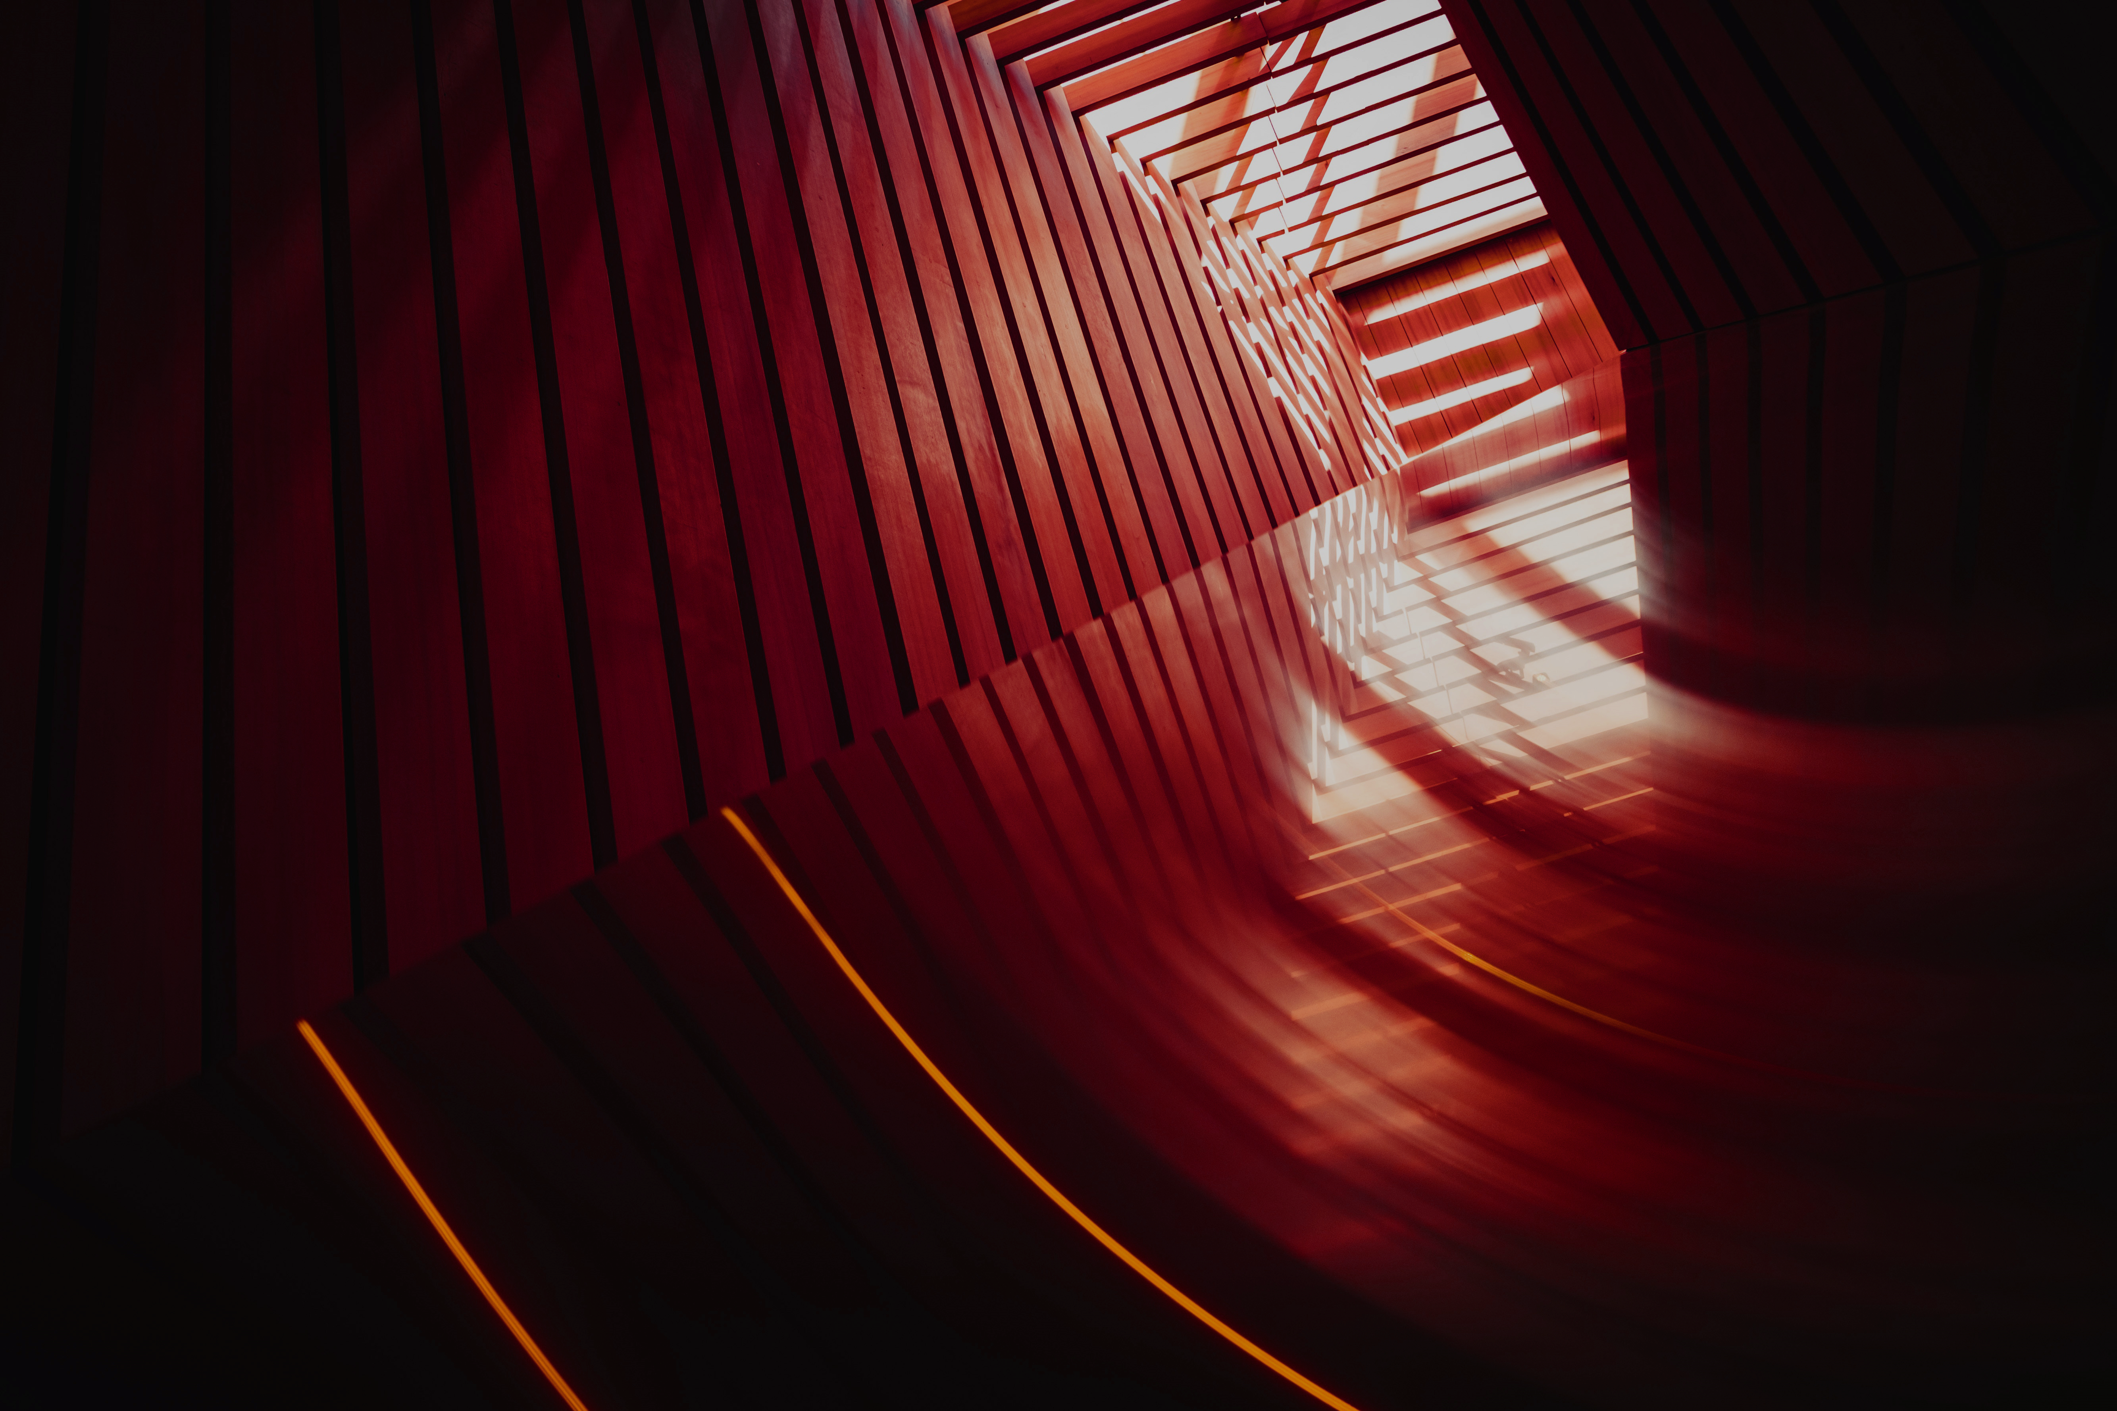
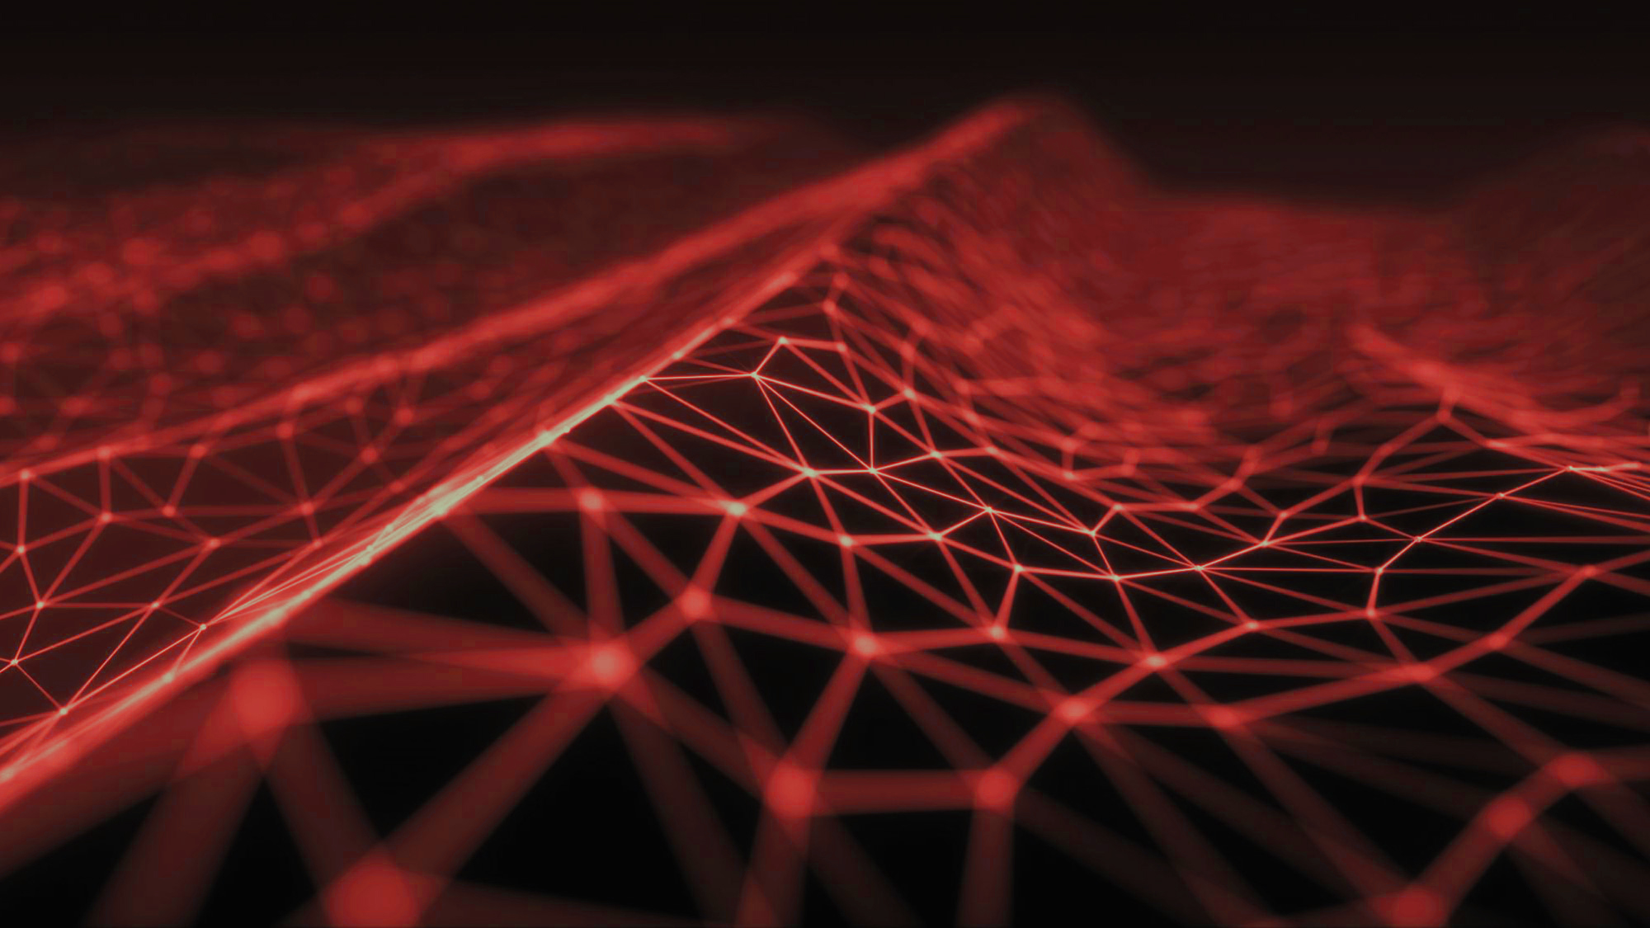

New XP Metal Detector
15/06/2022

Slide 2
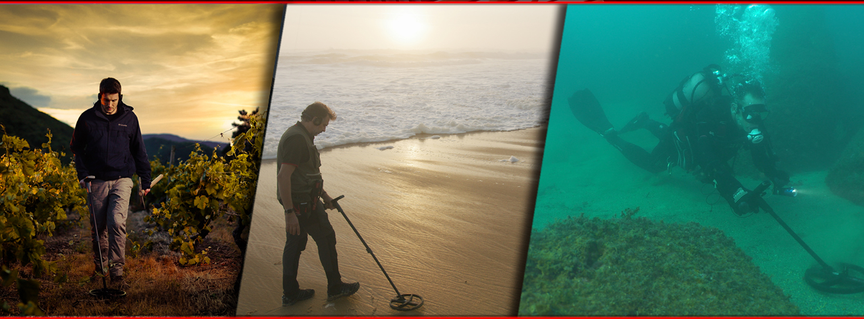
3D Metal Detector
3 d imentional Metal Detector
1st Dim. : One of the best on the field
2nd Dim. : One of the best on the beach
3rd Dim. : First MD underwater up to 20m deep with T.ID and with rich audio (BH-01)

Slide 3

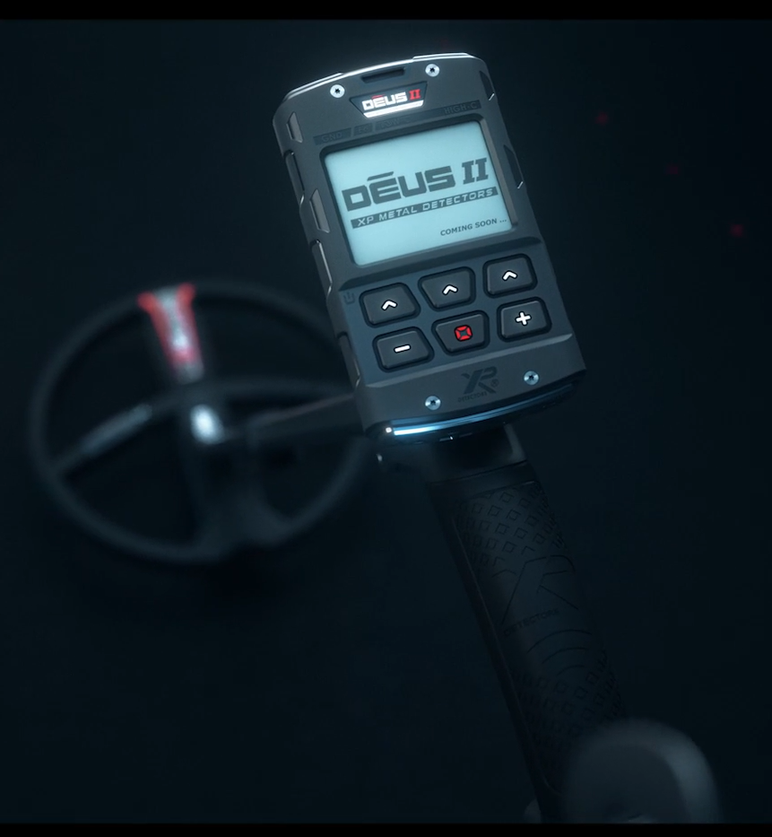
DEUS II Range available since the Launch
DEUS2-22FMF RC WS6
DEUS2-28FMF RC WS6
Composed by:
Ergonomic and Telescopic S-Stem
D22FMF or D28FMF coil
DEUS II Remote control
WS6 Headphones
1599€ sales tax included
(US$ 1599 MAP)
New models right now!
Thank you for the thousands pieces you already sold

Slide 4
A new model : DEUS II RC
DEUS II main features
Fast and simultaneous Multi Frequency
Waterproof up to 20m/66 ft deep
With T.ID available
With rich sounds underwater through the BH-01
Multi Audio options
4 band Equalizer
PWM, Square and more sound(s) to come
… and still Fully Wireless !

Slide 5
A new model : DEUS II RC
Link to the DEUS II RC video:
https://www.youtube.com/watch?v=9j5C2DVvOxM

Slide 6
A new model : DEUS II RC
DEUS2-22FMF RC
DEUS2-28FMF RC
Composed by:
Ergonomic and Telescopic S-Stem
D22FMF or D28FMF coil
DEUS II Remote control
1299€ sales tax included
(US$ 1299 MAP)

Slide 7
New optional headphones
Link to the new XP Headphones video:
https://www.youtube.com/watch?v=NL0w6GBEjK0

Slide 8
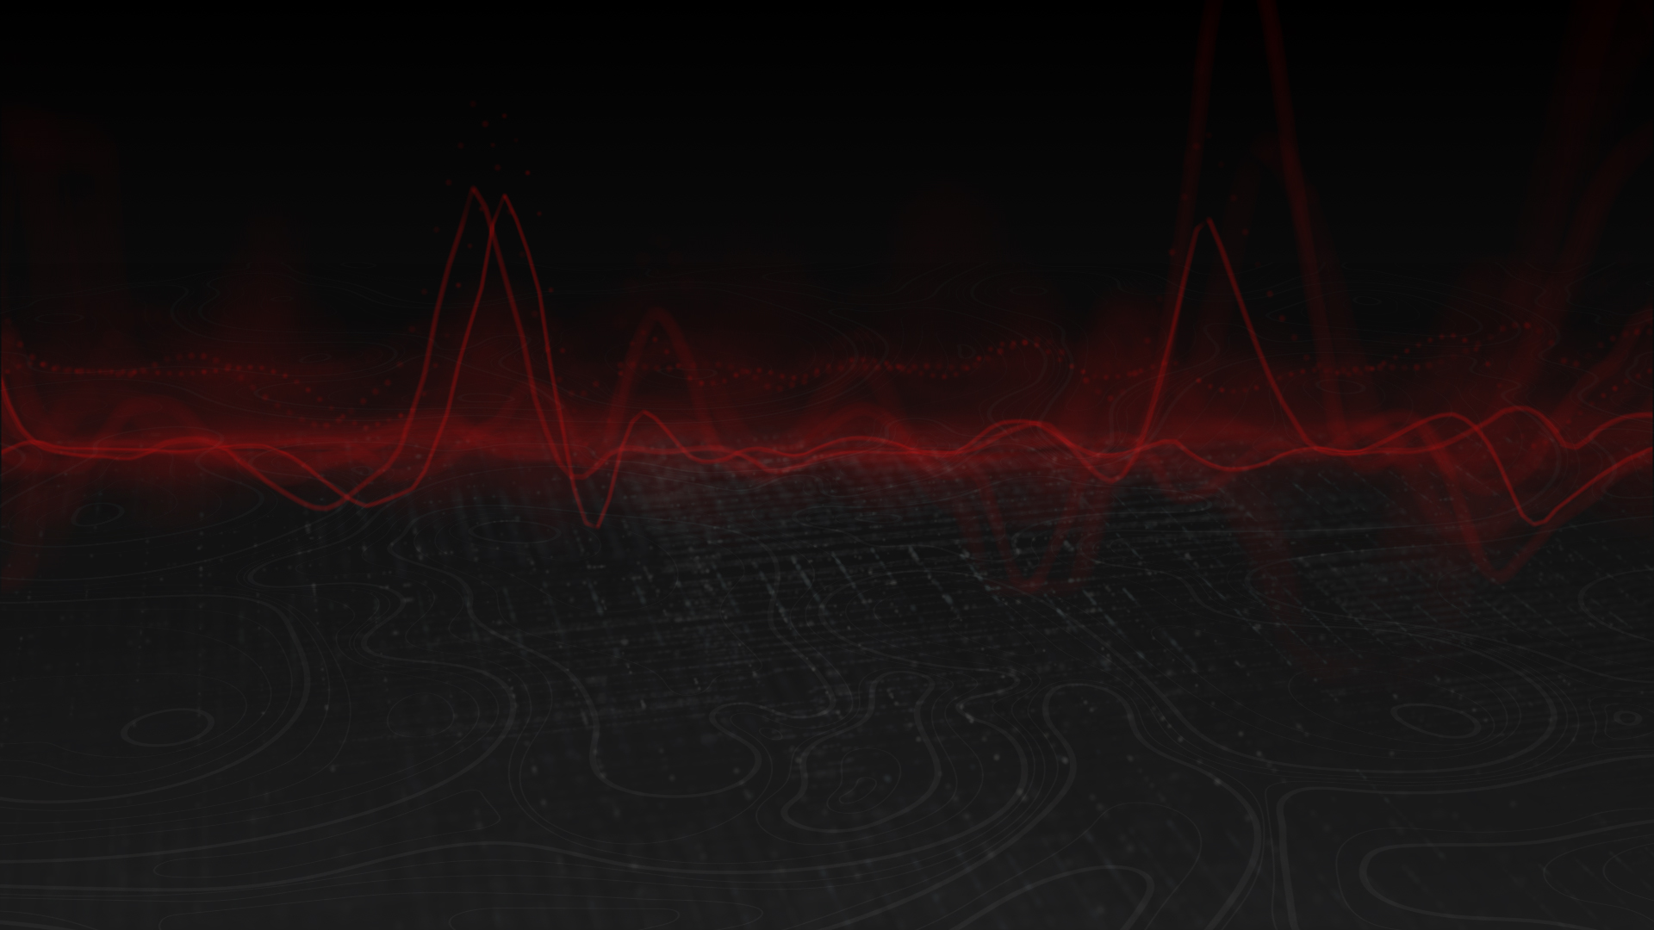
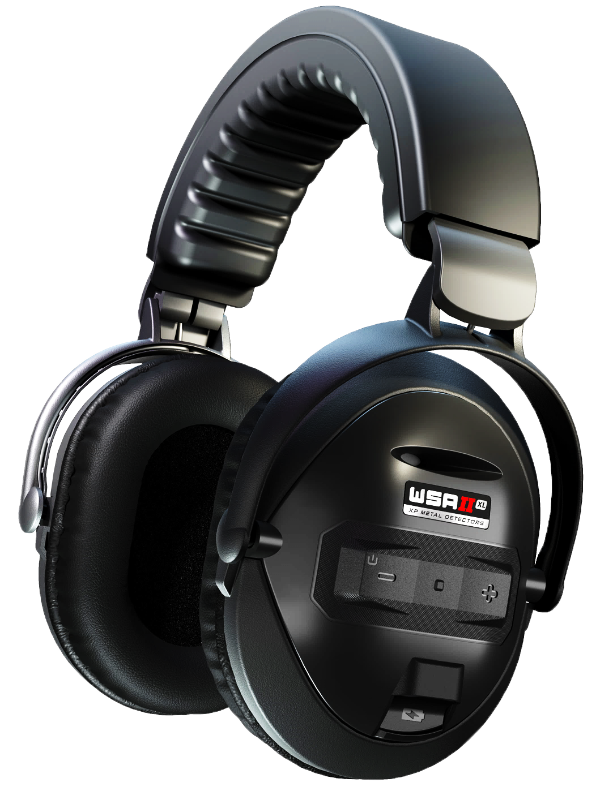
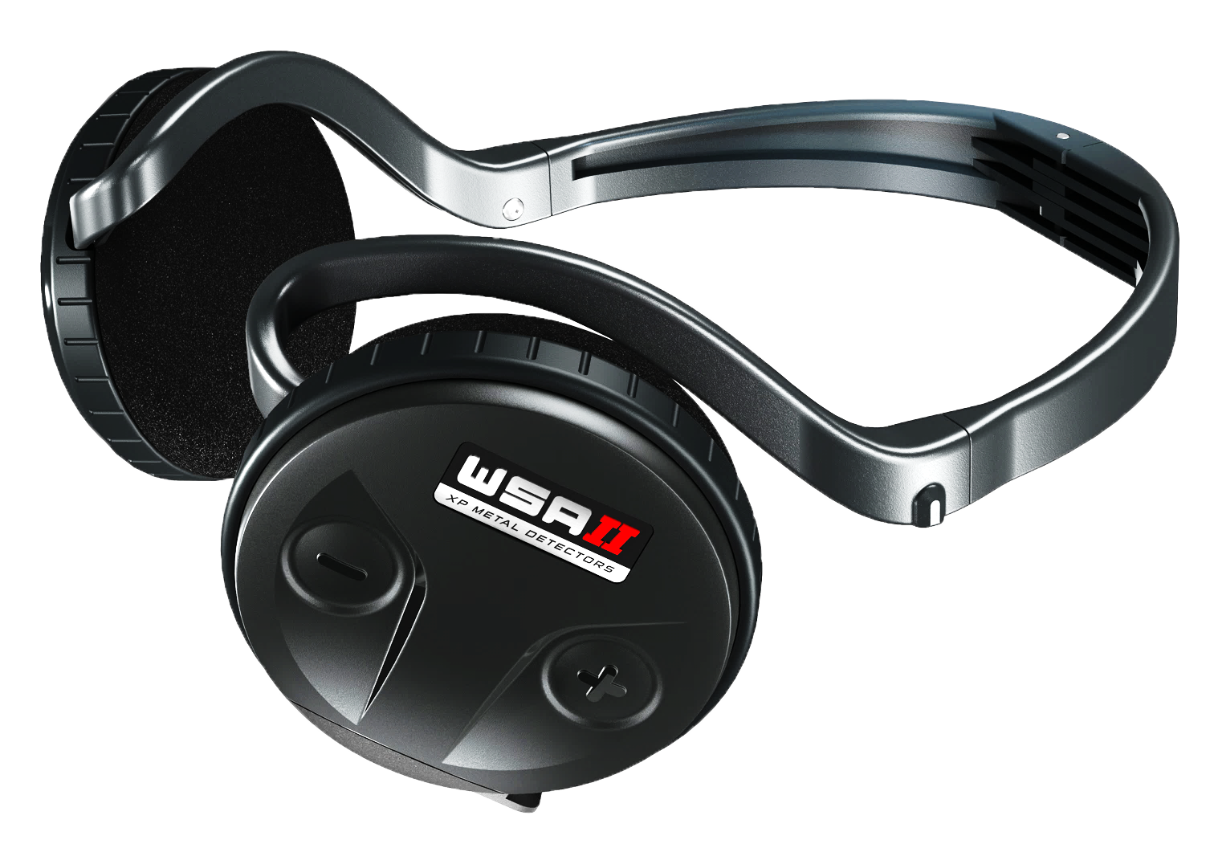
New optional headphones
WSA II and WSA II-XL new Headphones
10 time faster than low latency Bluetooth
Light (from 72g), Foldable, easy to transport
Rainproof (WSA II-XL - IP68 1m proofed)
4 band Equalizer :
10 level adjustable volume
Auto turn on/off once paired to the RC or the WS6
5 hours Auto-off if paired (otherwise 5 min)
Lithium battery
Fast charge (2 hours)
2 year warranty
Battery life led indicator
20~20,000 Hz audio frequency
2.400 GHz ~2.480 GHz radio frequency
5 year warranty Headphones
Made in France
The WSA II-XL has been proofed IP68 1meter deep although it was not designed to dive, that just proves its robustness against waves or if you drop them into water
Your sound preferences at your fingertips.
With the 4 band Equalizer, adjust the bass and treble for the most effective sound.
The Equalizer is perfectly designed for the WSA II-XL. We suggest that you set your personal equalization to reduce the medium audio, ringing around 500Hz, common to the over-ear headphones.
We recommended this adjustment below with the WSA II-XL to get a warm sound
Increase the bass and the treble and decrease the medium
150Hz: +6dB
450Hz: 0dB (or -3dB)
2kHz: +3dB
4kHz: +6dB (or +9dB)
Of course, each of you can mix the EQ to your own perception and audio preferences

Slide 9

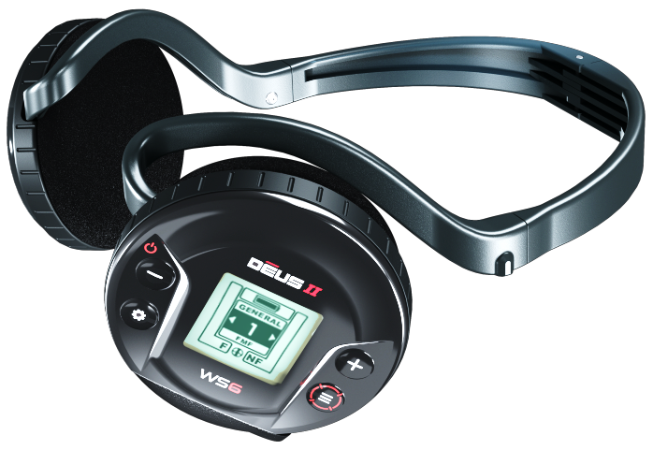
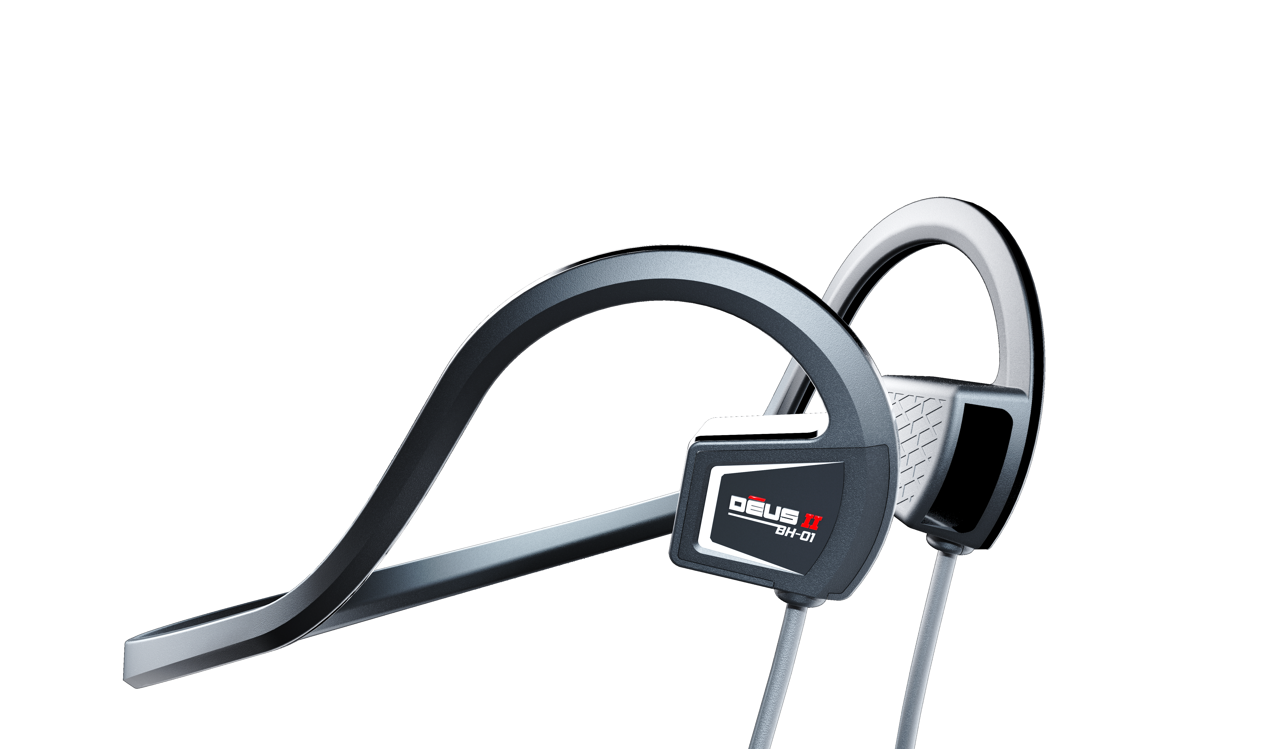
New optional headphones
WSA II (149 €/US$)
WSA II-XL (199 €/US$)
WS6 (349 €/US$)
BH-01 (69,90 € / 69,90US$)

Slide 10
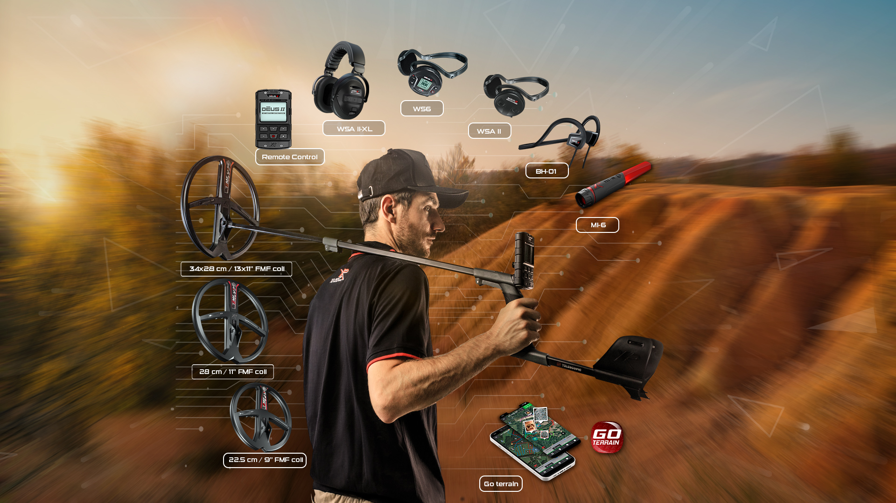

DEUS II Wireless Universe
All devices communicate wirelessly
D28FMF
WSA II-XL
D2-RC
WS6
WSA II
D22FMF
D3428FMF
BH-01
MI-6
GO TERRAIN

Slide 11

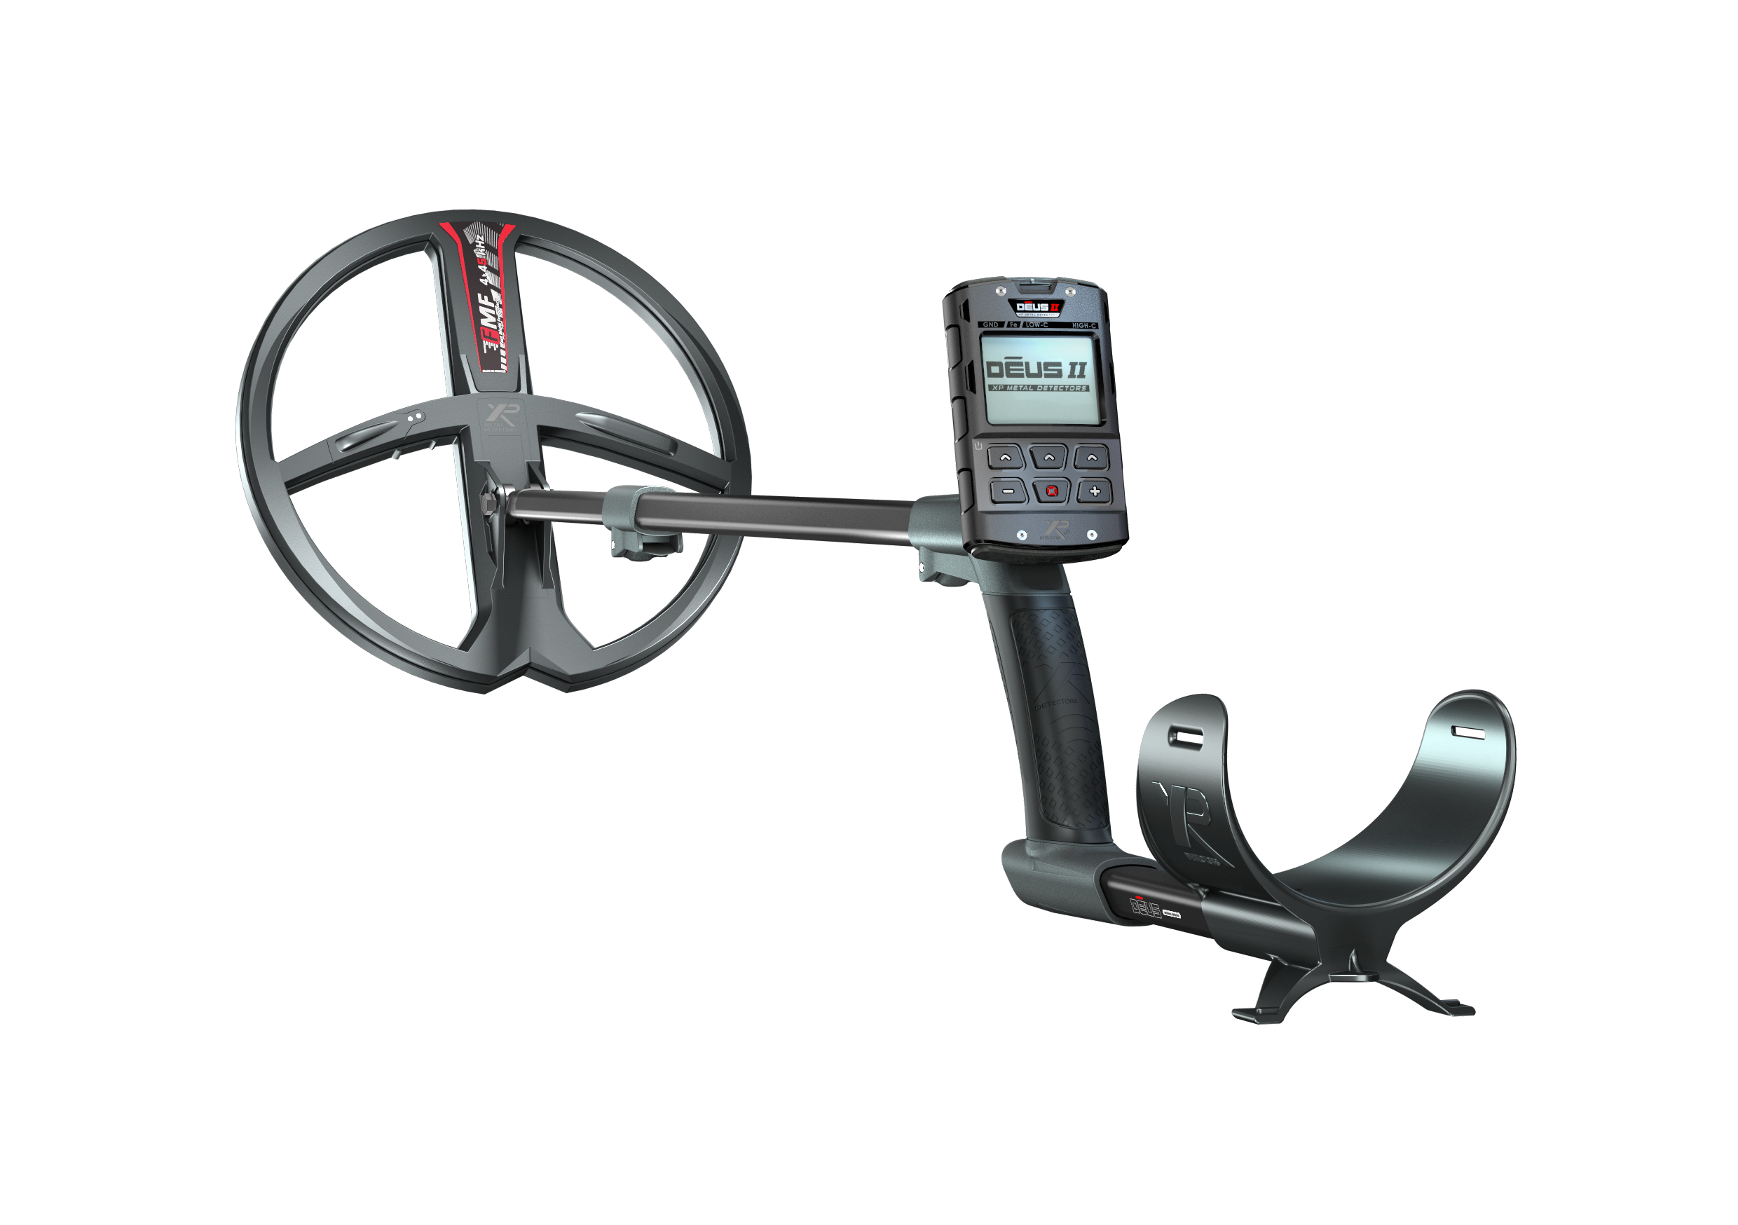
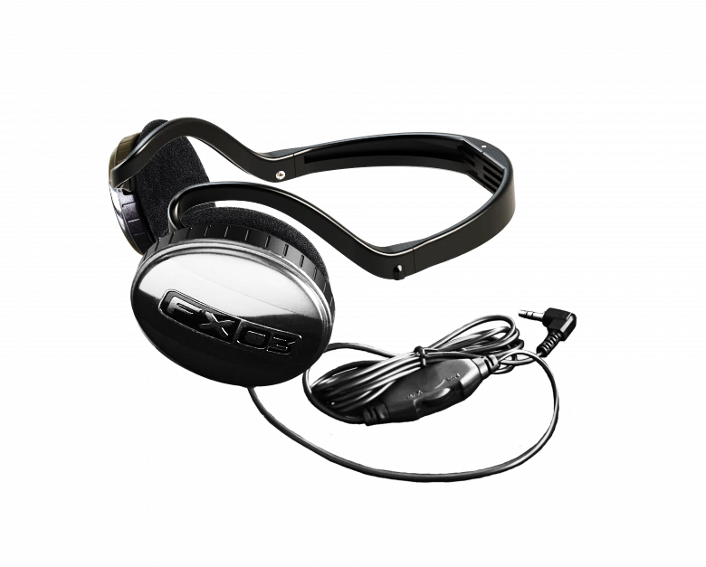
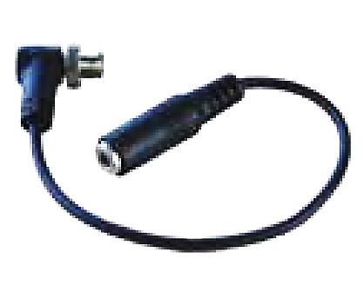
DEUS II Range is growing
DEUS II FULL
DEUS2-22FMFRCWS6
DEUS2-28FMFRCWS6
DEUS II RC
DEUS2-22FMFRC
DEUS2-28FMFRC
Options*: WS6 / WSA II / WSA II-XL
More options*: BH-01 / Adapter + FX03

Slide 12
Do it Yourself : make your own bundles
With 2 detectors and 5 headphones in stock you can build your own
14 models of DEUS II detectors :
DEUS II RC + WS6, the DEUS II FULL you are selling since the launch
+
DEUS2-22FMFRCWS6
DEUS2-28FMFRCWS6

Slide 13
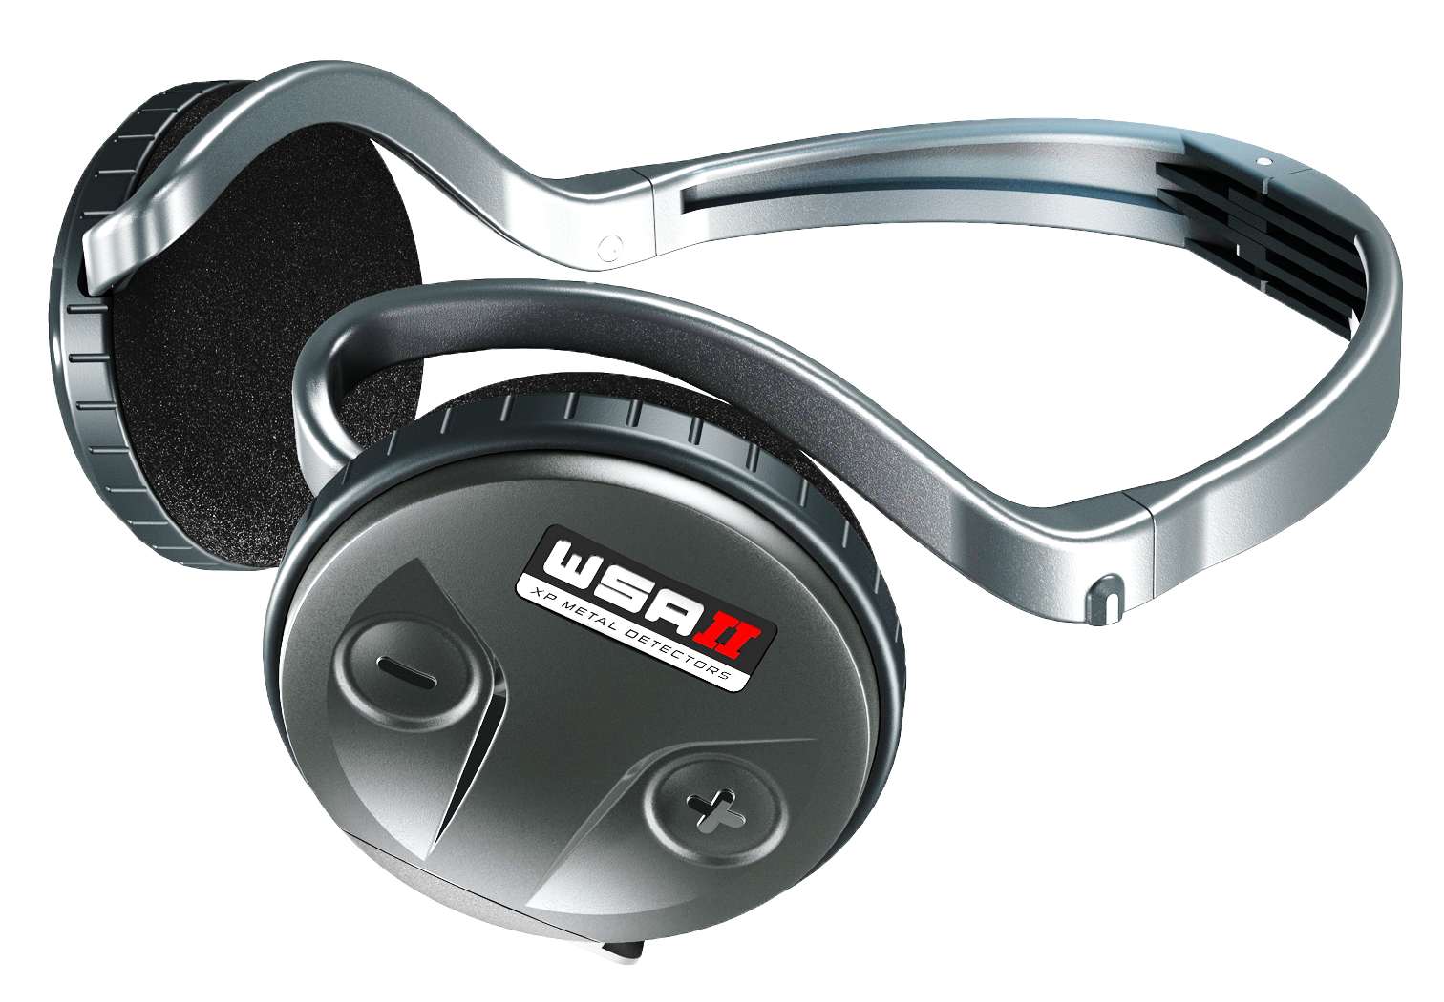
Do it Yourself : make your own bundles
With 2 detectors and 5 headphones in stock you can build your own
14 models of DEUS II detectors :
DEUS II RC + WSA II
+
DEUS2-22FMFRCWSAII
DEUS2-28FMFRCWSAII

Slide 14
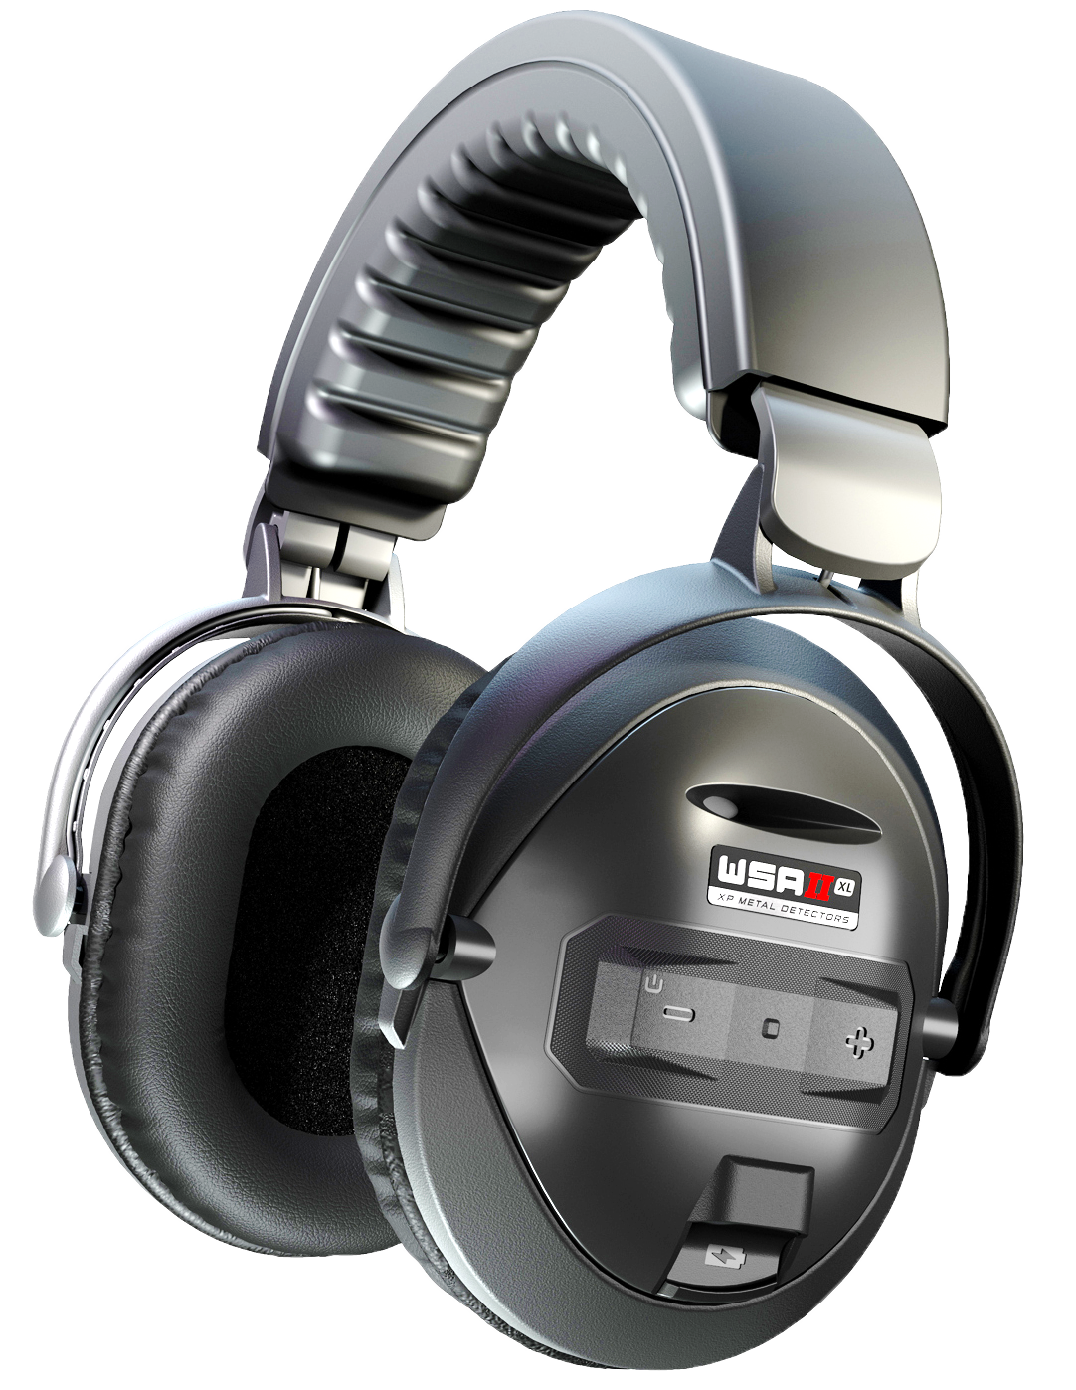
Do it Yourself : make your own bundles
With 2 detectors and 5 headphones in stock you can build your own
14 models of DEUS II detectors :
DEUS II RC + WSA II-XL
+
DEUS2-22FMFRCWSAIIXL
DEUS2-28FMFRCWSAIIXL

Slide 15
Do it Yourself : make your own bundles
With 2 detectors and 5 headphones in stock you can build your own
14 models of DEUS II detectors :
DEUS II RC + BH-01
+
DEUS2-22FMFRCBH01
DEUS2-28FMFRCBH01

Slide 16
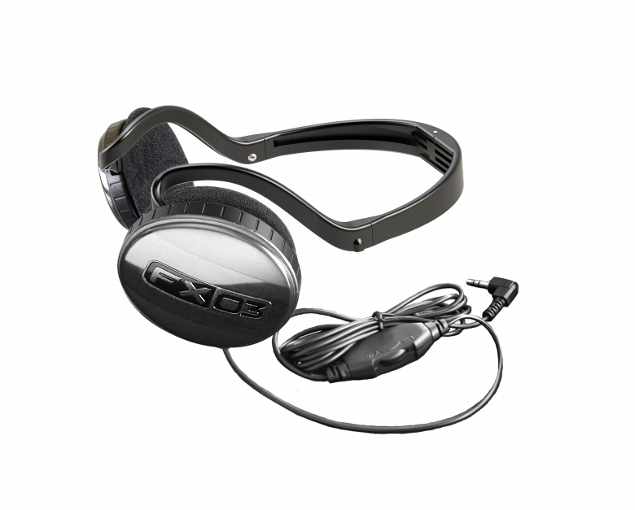
Do it Yourself : make your own bundles
With 2 detectors and 5 headphones in stock you can build your own
14 models of DEUS II detectors :
DEUS II RC + jack adapter + wired headphones of your choice ( FX03 )
+
+
DEUS2-22FMFRCFX03
DEUS2-28FMFRCFX03

Slide 17
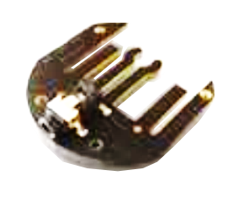
Do it Yourself : make your own bundles
With 2 detectors and 5 headphones in stock you can build your own
14 models of DEUS II detectors :
DEUS II RC + WSA II + D099 + end-user wired HP
+
+
DEUS2-22FMFRCWSAII*
DEUS2-28FMFRCWSAII*

Slide 18
Do it Yourself : make your own bundles
And you can imagine other bundles like :
DEUS II RC + WSA II + BH-01 (for field and diving)
+
+
ETC… up to you

Slide 19
Do it Yourself : make your own bundles
With 2 detectors and 5 headphones in stock you can build your own
At least 14 models of DEUS II detectors :
7 models with the 22FMF coil (9”)
7 models with the 28FMF coil (11”)
Models in 22cm FMF coil | Models in 28cm FMF coil | Type of usage/customers
DEUS2-22FMFRC | DEUS2-28FMFRC | Wired headphones preference
DEUS2-22FMFRCFX03 | DEUS2-28FMFRCFX03 | XP Wired headphones
DEUS2-22FMFRCWS6 | DEUS2-28FMFRCWS6 | Full DEUS II
DEUS2-22FMFRCWSAII | DEUS2-28FMFRCWSAII | The lightest wireless headphones
DEUS2-22FMFRCWSAIIXL | DEUS2-28FMFRCWSAIIXL | Comfortable and anti-noise headphones
DEUS2-22FMFRCBH01 | DEUS2-28FMFRCBH01 | For divers and noisy environment
DEUS2-22FMFRCWSAII* | DEUS2-28FMFRCWSAII* | To use your own wired HP in fast wireless mode

Slide 20

eXPlore like never before

