Slide 1



New XP Metal Detector
July 11th 2023

Slide 2
AGENDA
Your contacts
New metal detector introduction
  Video
  Key Features
  Global and detailed specifications
  Test feedbacks
  References and prices
  Accessories release
  Q&A

Slide 3
XP Team
For Order/shipment/customS TOPIC :
Svetlana PLIUSNINA: s.pliusnina@xpmetaldetectors.com
Kamal LOUALI: k.louali@xpmetaldetectors.com
For BUSINESS topic:
Elise ALBA: e.alba@xpmetaldetectors.com
Philippe COLIN: p.colin@xpmetaldetectors.com
For Marketing topic :
Lucille LASSINAT: l.lassinat@phxsupport.fr
Benjamin CINQUIN: b.cinquin@phxsupport.fr
FOR REPAIR TOPIC :
CLAIRE & JEAN : sav2@xpmetaldetectors.com

Slide 4
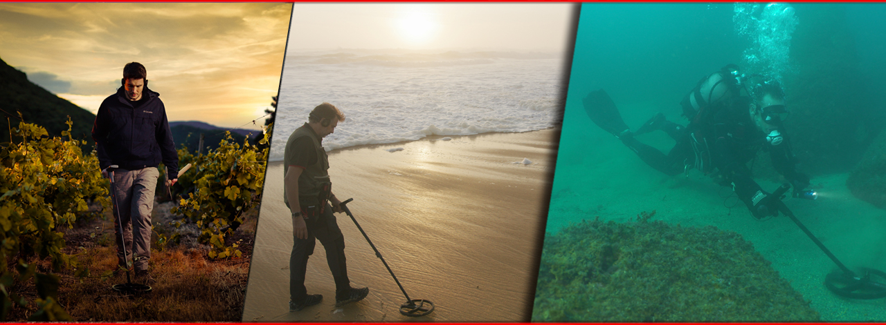
The most VERSATILE metal detector
One of the best on land
One of the best on the beach
Detect up to 20m(66ft) underwater … 3 machines in 1

Slide 5
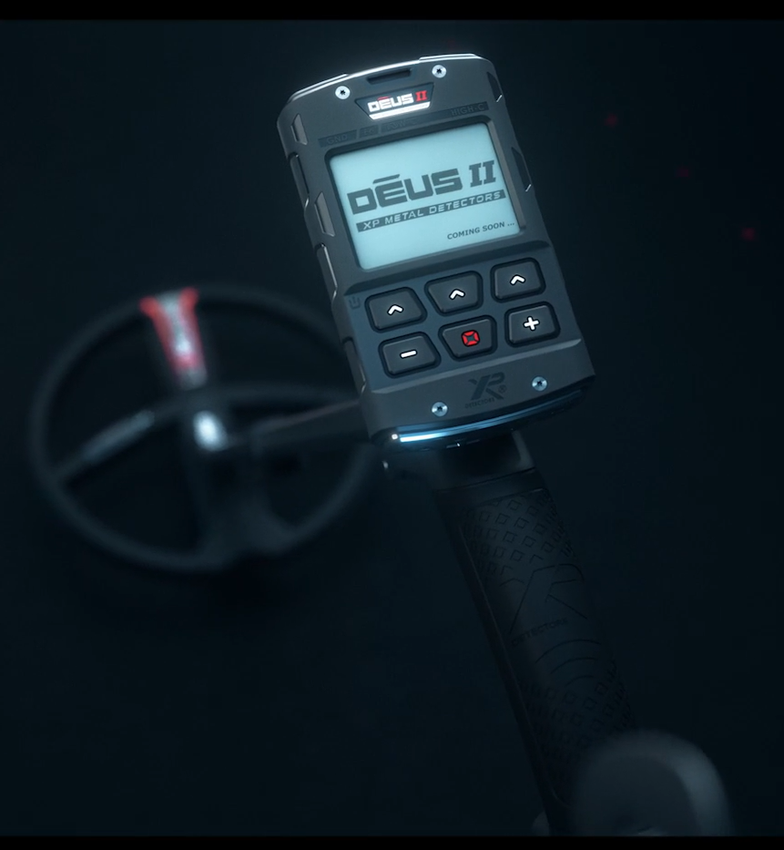
EVOLUTION from 2022 to 2023
V0.3 ➔ V1.1
        Full Tones improvements
        Frequency MAX
        Audio Filter
        Hi-Square audio type
        Faster T.Id
        Fe T.Id
        Silencer
Now V2.0

Slide 6
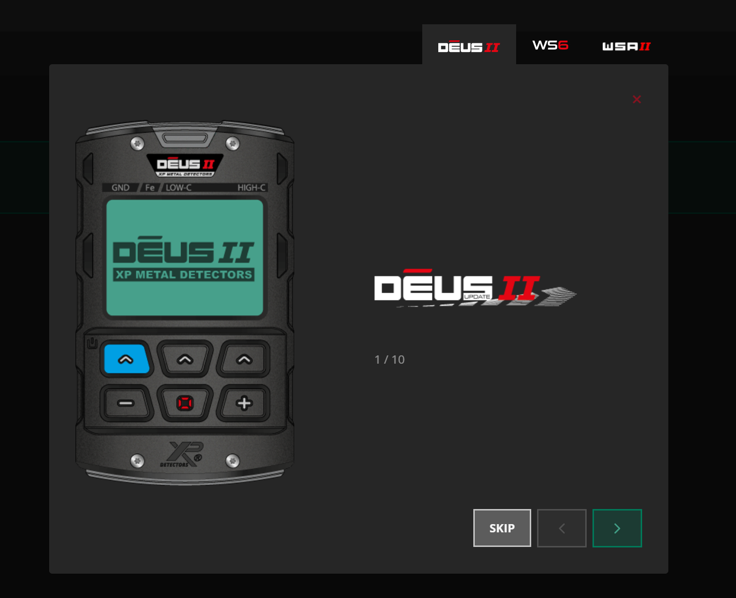
My account on www.xpmetaldetectors.com
Update your equipment from this platform
Get all information about our updates in our blog https://www.xpmetaldetectors.com/en/bt/the-blog/updates.php

Slide 7
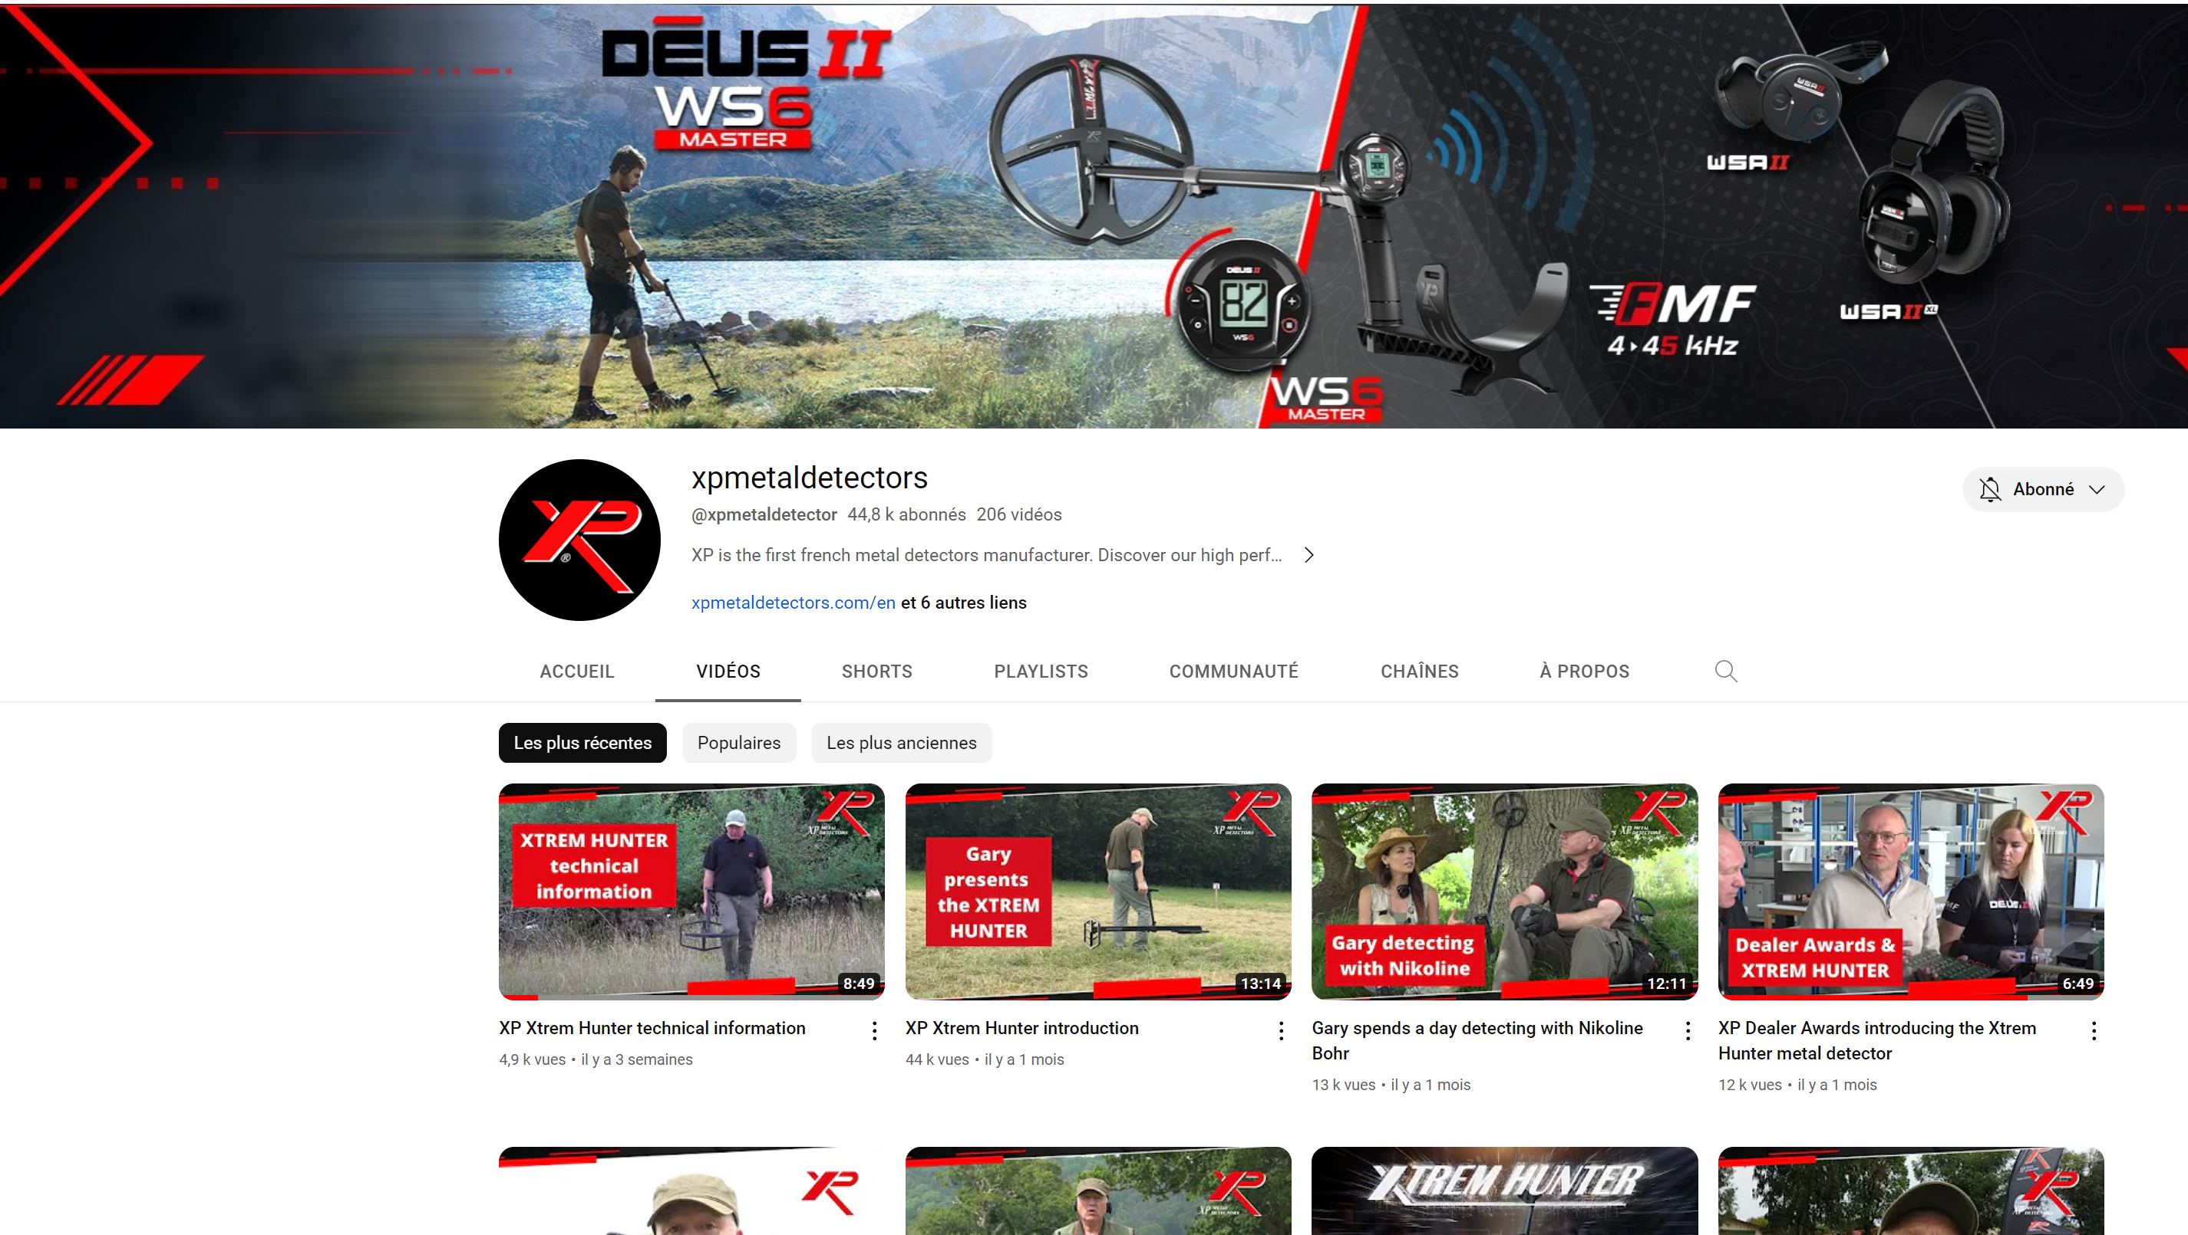
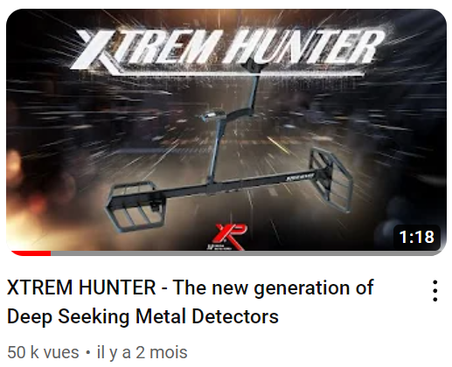
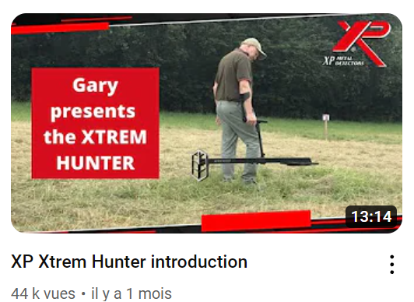
You already discovered the
XTREM HUNTER on our Youtube channel

Slide 8


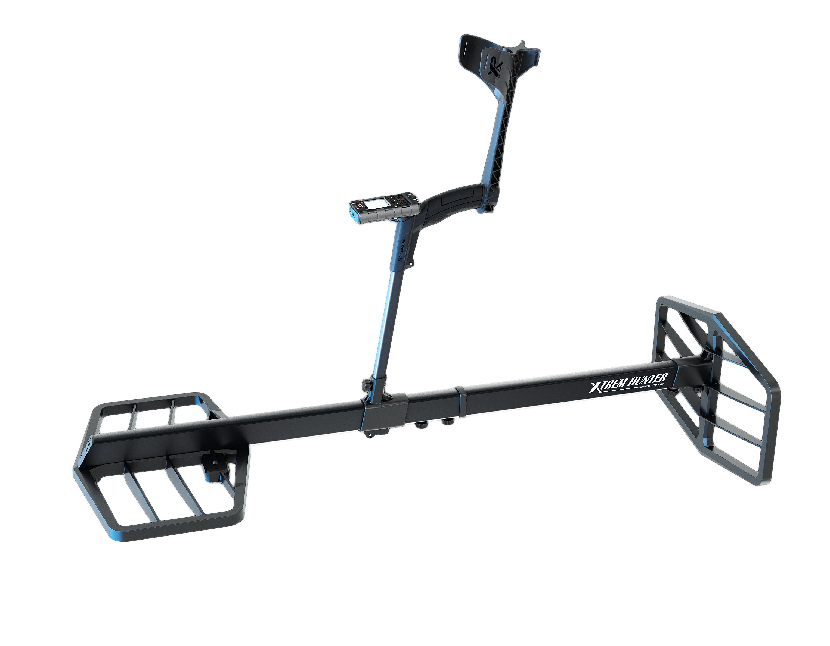

eXPlore like never before

Slide 9
When DEUS II becomes an XTREM HUNTER
Extremely deep seeking detector for large targets
ideal for archeologists (large relics recovering)
ideal for industrial workers (tanks and large pipes loc.)
ideal for passionate detectorists (deep hoard recovering)
eXPlore like never before

Slide 10
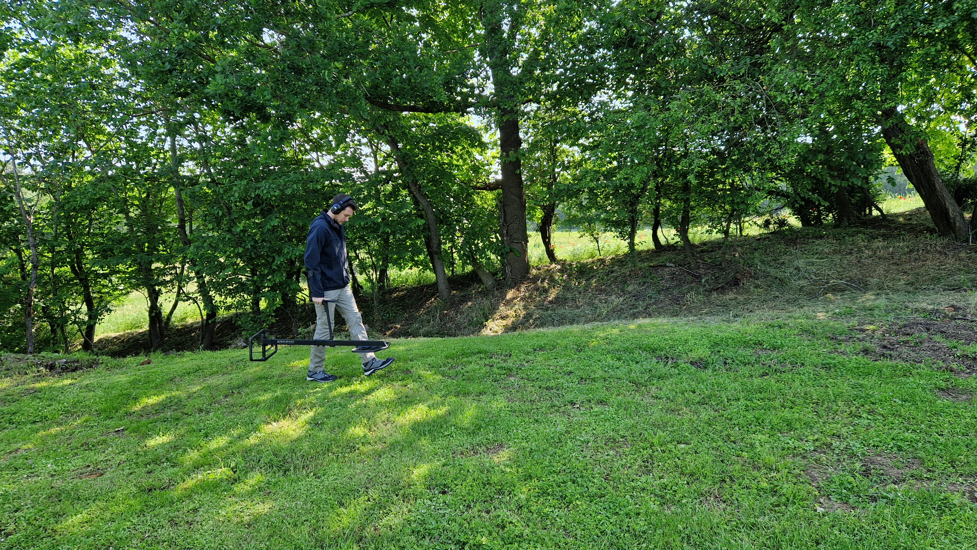
Key Features
Fast and simultaneous Multi Frequency
Reach extreme depths (up to 5m~17ft)
Discrimination capability
Wireless convenience
Ergonomic, weather-ready and Built to last

Slide 11






Product specifications
Large “2 Box” FMF coils (2 coils 1’x1,5’)
  Unparalleled performance : up to 5 meters (17 ft) deep
  Less ground noise than any other 2 box deep seeking detector
First fully wireless multi freq. m.D.
  Detachable remote control with USB update system → V2.0
  Switch from XTREM HUNTER to DEUS II in seconds
  S-telescopic and adjustable stem – easy to adjust, easy to store
Long battery life with Lithium batteries
  Up 10 hours on the field
Fast audio response with wireless headphones
4 different Headphones to suit to all usages : WS6, WSA II, WSA II-XL, BH-01
10 Times faster than any Bluetooth low latency headphones
wEatHer proof & shockproof
5 year warranty – made in France
XP : the unique metal detector brand with such long warranty
Simultaneous FMF
Up to 5M Deep (17ft)
Fast Wireless
XP Link
Update
Lithium
batteries
Built to last

Slide 12
Detailed specifications
General tech :
Simultaneous fast multiple frequency (FMF®)
Non-motion with adjustable autotune
XP wireless headphone compatibility
Battery type: li-ion 18650 x1 - 11 watts/hour - 45g
  Battery life >10 hours - full charge in ±4 hours
  T° during charging: 0 to + 40° max
  Operating T°: 0 to + 40°
Charge cable: USB-C
XP case: included - rain and shock proof
XP case size: 725 x 480 x 170 mm (28’ x 18,9’x 6,7’)
Length assembled: 1.20m (3.94ft)
Weight (XTREM HUNTER + remote control): 2.9kg (6.4lb)
Weight (XTREM HUNTER + XP case): 5.8kg (12,8lb)
XP BACKPACK 280 : optional
Warranty:
  5 years parts and labor
  Batteries and connectors 2 years.
Patent: US 7940049 B2 - EP 1990658 B1 + patents pending
Settings:
Adjustable Autotune
Sensitivity
Reactivity
Discrimination (Iron rejection)
Audio Response
Frequency scan
  EMI noise cancel
  Auto/manual with 14 channels
Ground Balance : manual/grab
Audio threshold
Equalizer
Programs

Slide 13
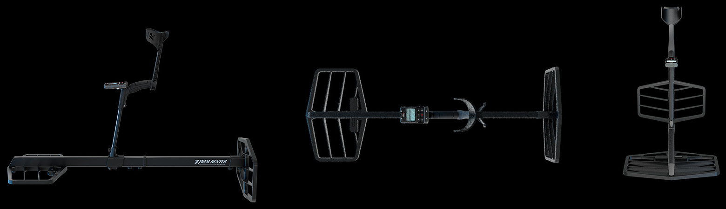
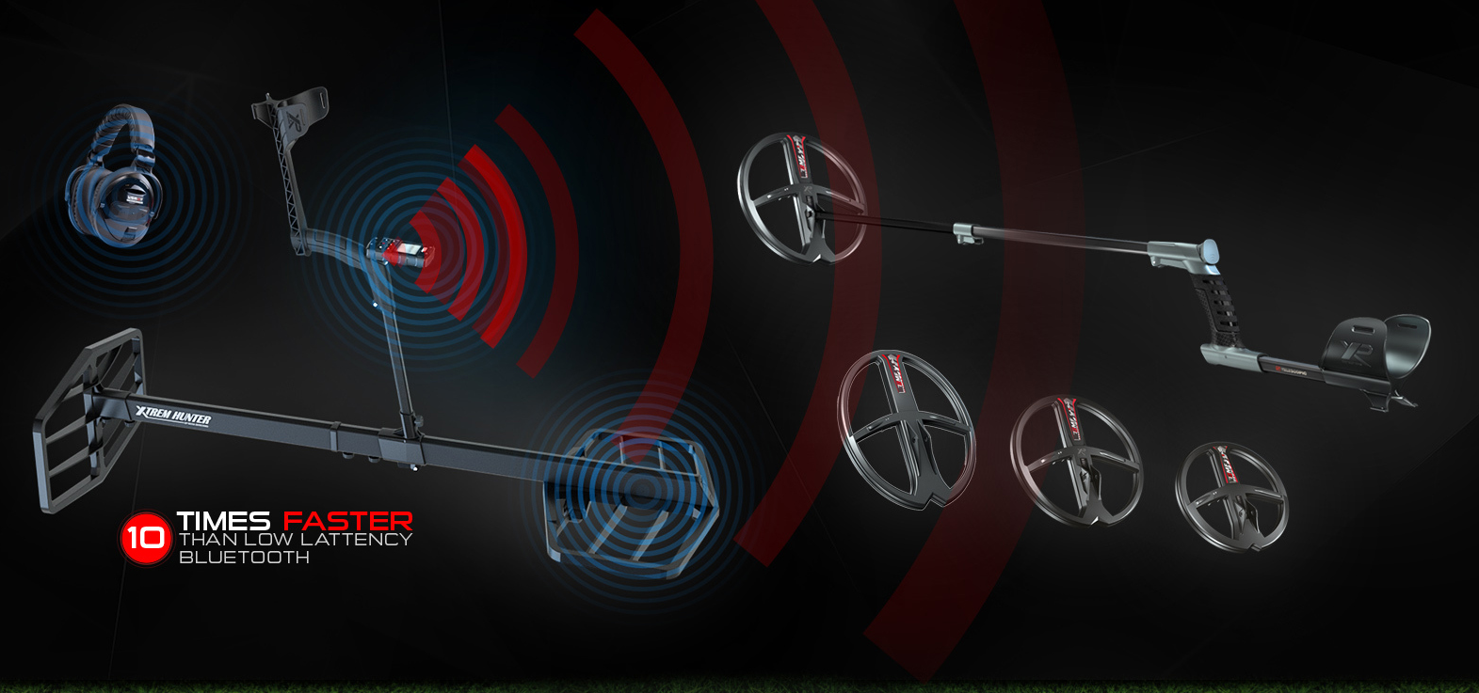
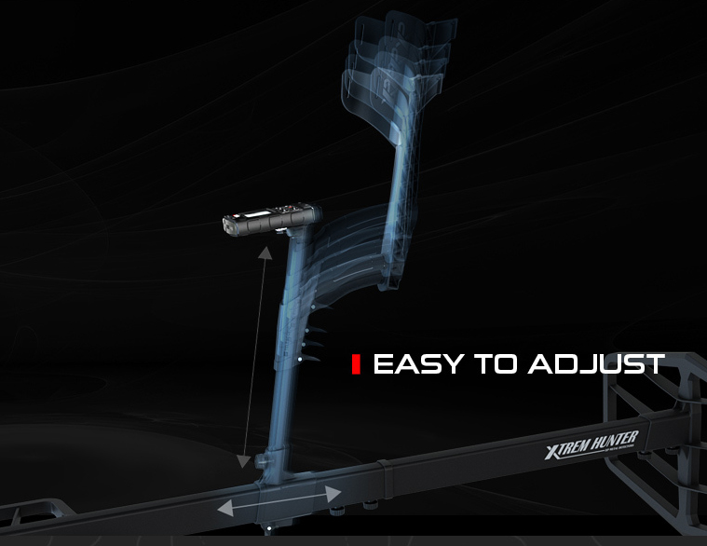
Extreme versatility

Slide 14
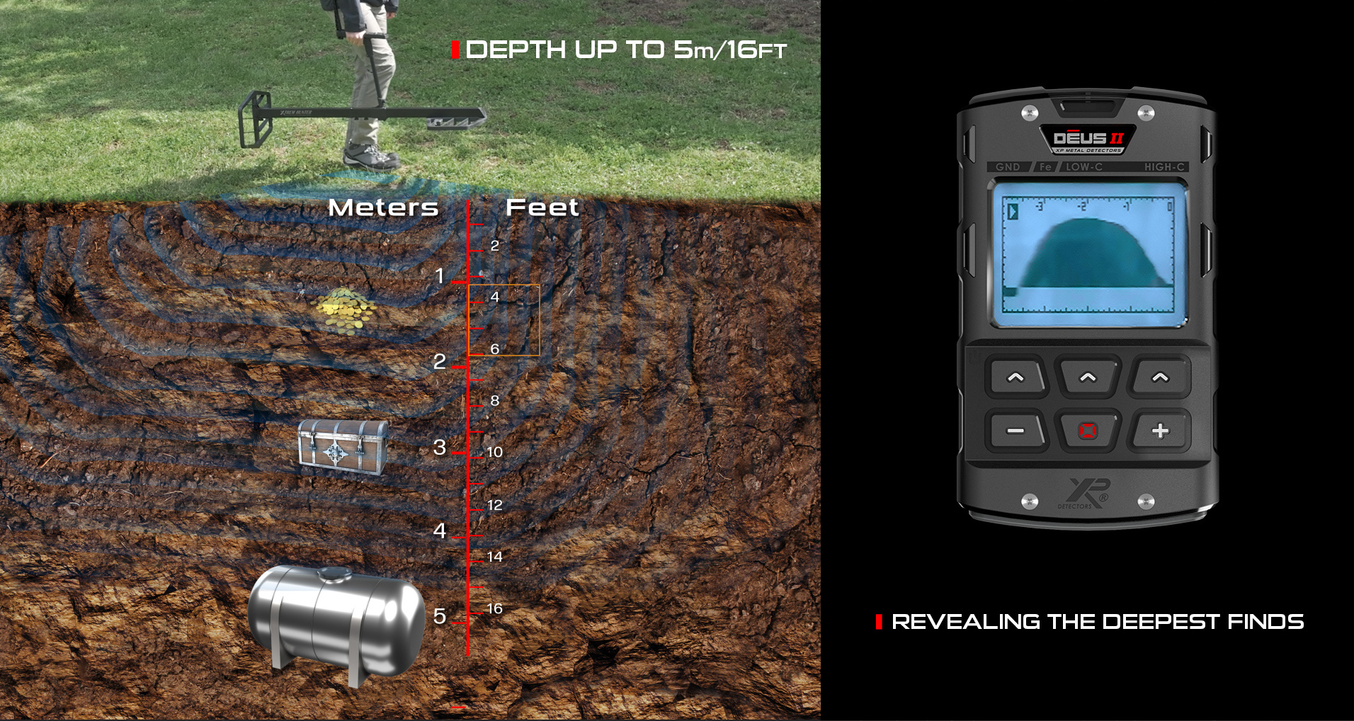
Performance and Bar graphic

Slide 15
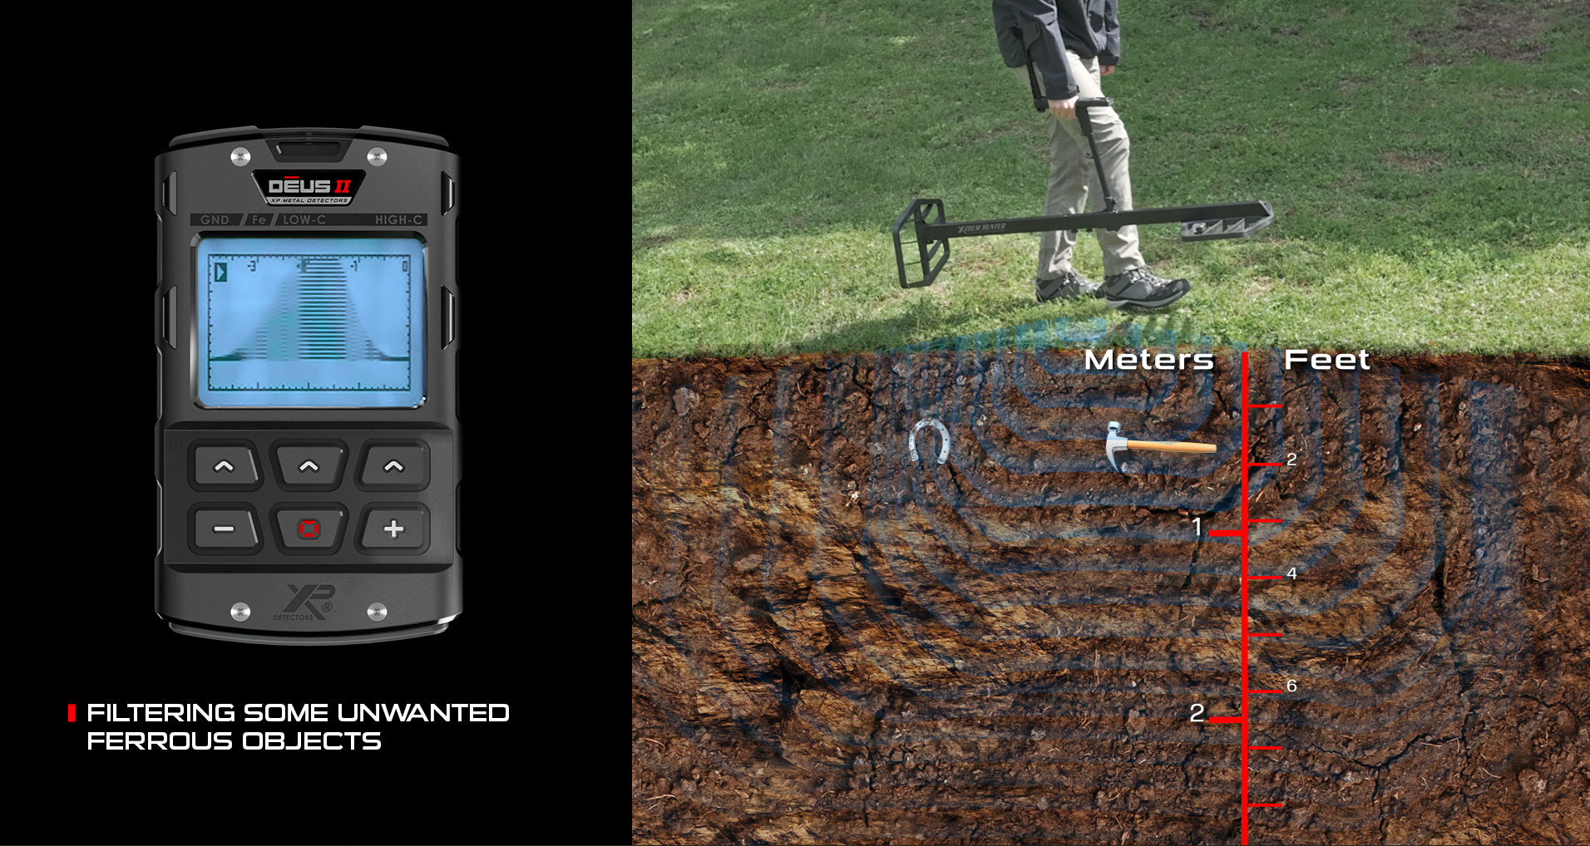
Bar graphic and iron rejection
MODERATE SIZE FERROUS
REJECTION

Slide 16
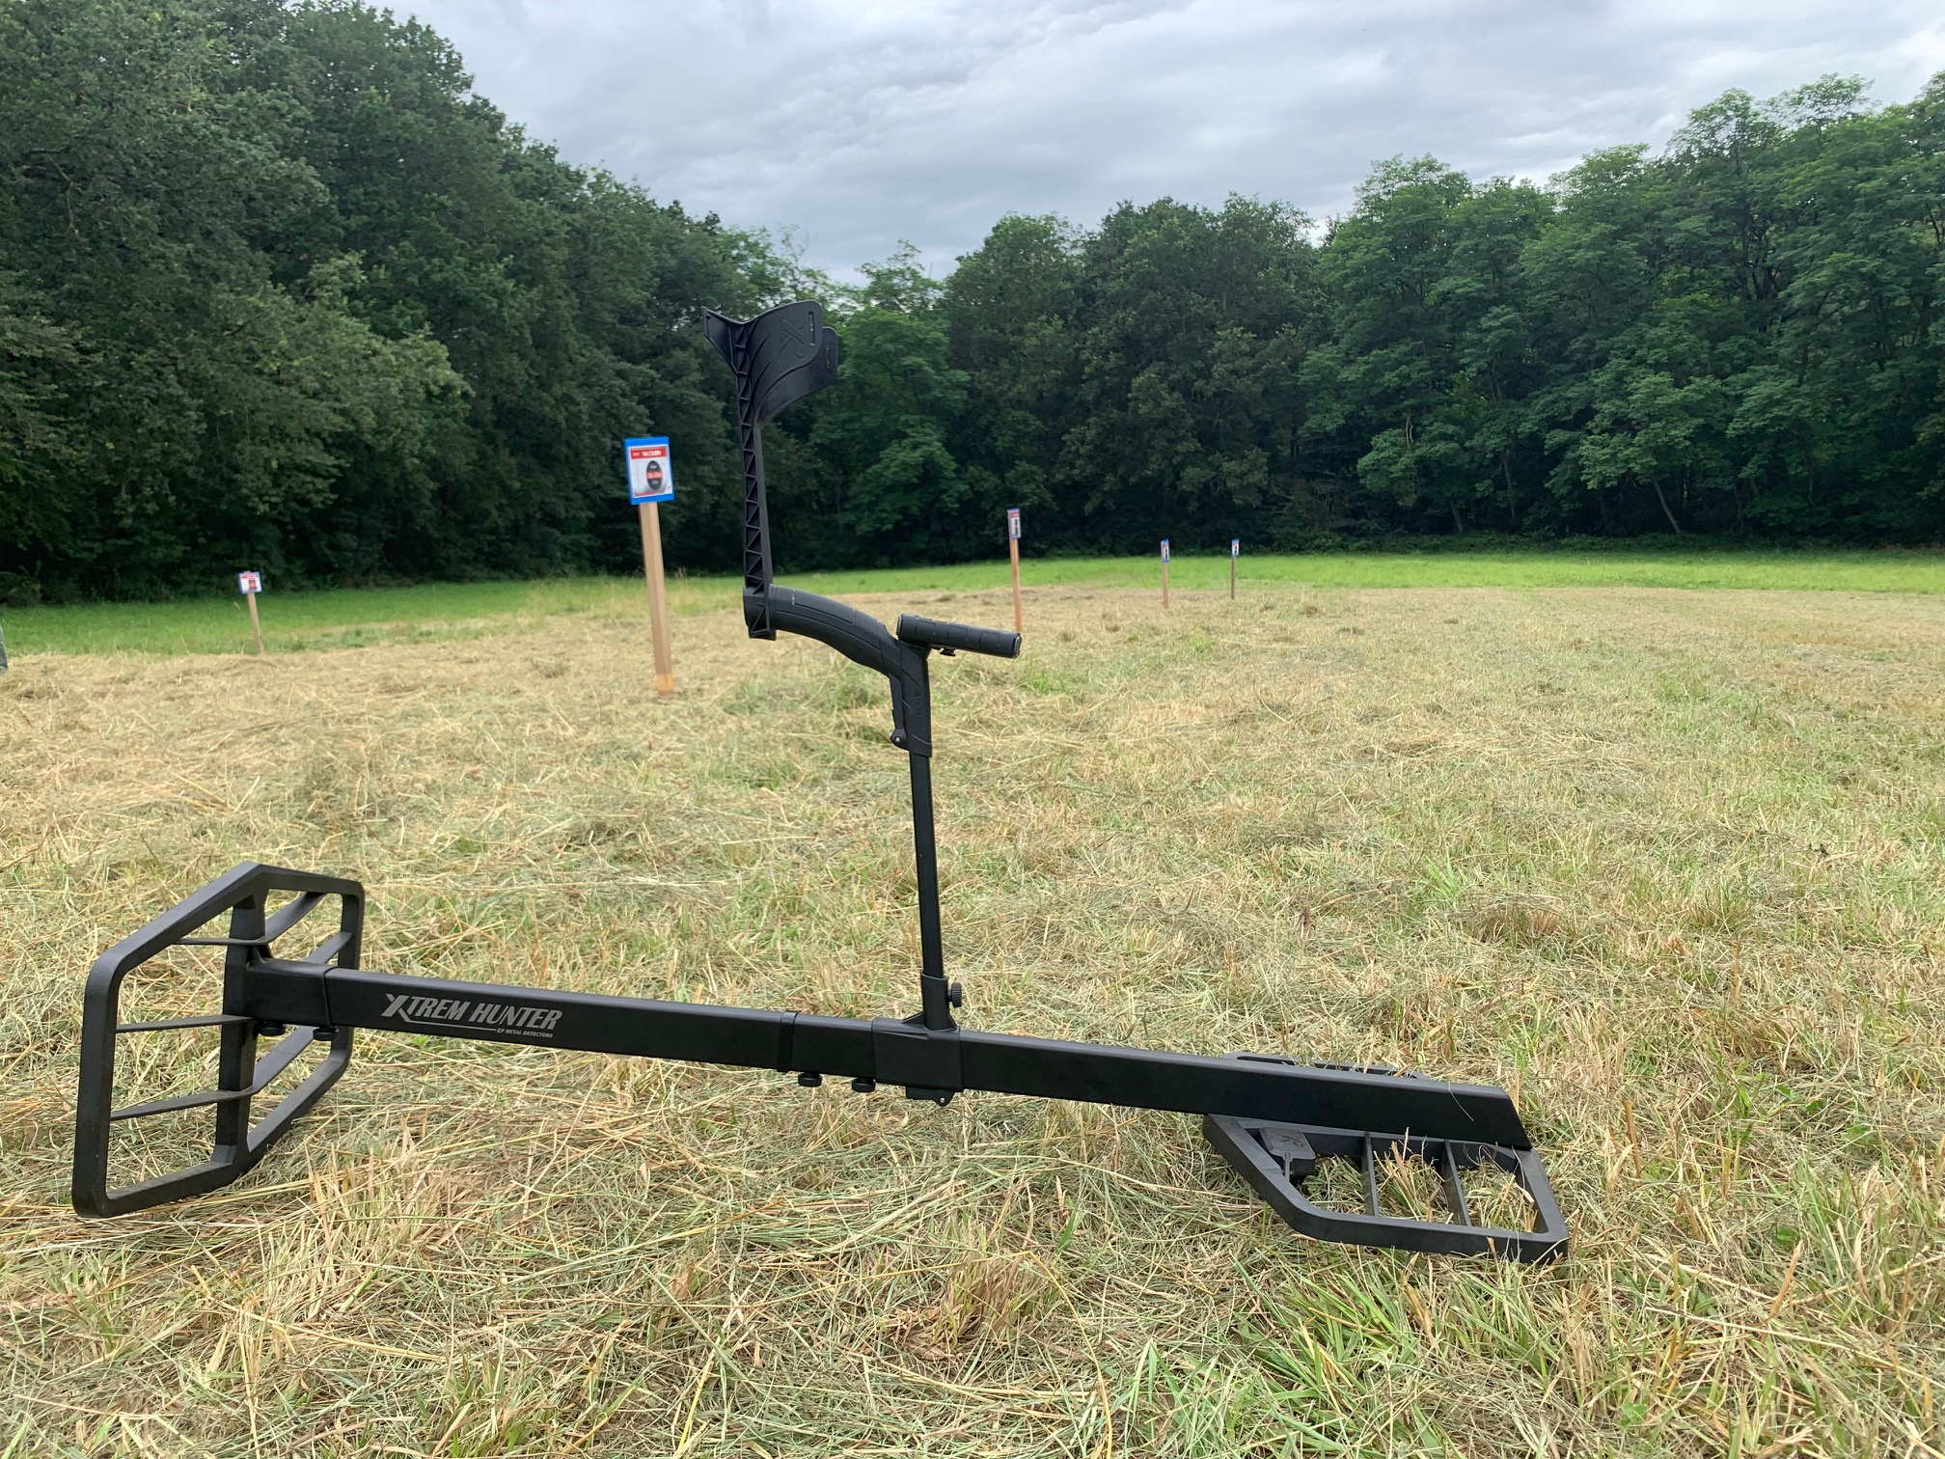
Test field
5000 m² with buried targets to test the XTREM HUNTER
Come with your resellers to make test and videos
Come with your Youtubers/Influencers to make videos
Visit XP Factory

Slide 17
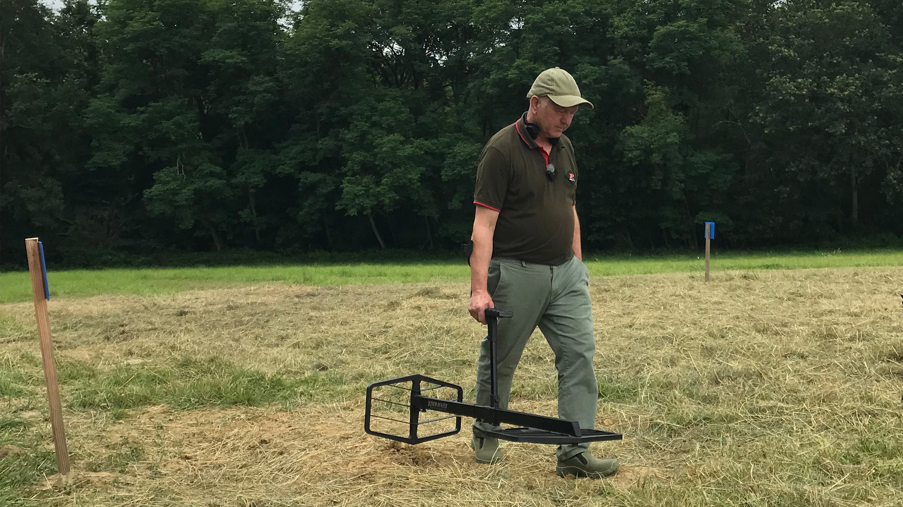
Test field
XTREM HUNTER is a very interesting concept. It uses the very last technology. Built around a rugged lightweight platform, making this machine a professional tool for all weathers and terrain.
XTREM HUNTER is world’s first Multifrequency twin box, which i’m sure will open up a wider range of possibilities for the dedicated professional. All based around DEUS II platform making this a cost effective addition to the XP armoury.
GARY first tests
#1:
#2:
#3:
#4:
Videos are now online
https://www.youtube.com/user/xpmetaldetector/videos
Impressive performance
Stable machine
Low tone iron rejection
Useful Bar graphic

Slide 18
5 important things to know
#1: Do not keep any smartphones, keys, buckles, or metallic shoes
on or around you!
#2: Hiking shoes include metal parts. Only use sports shoes or
rubber boots. Double check with MI-6 pinpointer to be sure.
#3: Always use headphones with the XTREM HUNTER, wide audio
dynamic range vs the remote control speaker.
#4: To test the XTREM HUNTER's response:
1. Place large targets of different sizes (25cm to >1m) on the ground
2. Raise your detector to 1.5m with your arm and pass over the targets.
#5: Do not pass any target above the XTREM HUNTER.
1. It only accurately detects objects on its bottom side (ground side).
2. So if you move a target on the top for your test, it will not detect it correctly and the threshold will
move in the wrong direction.

Slide 19
XTREM HUNTER Range at Launch
XTR-115
XTREM HUNTER COIL BUNDLE
  XTR115TX and XTR115RX FMF COILS
  XTR-STEM : specific S-TELESCOPIC Stem
  XTREM HUNTER specific user manual
  Accessory kit (no charger)
  XTR-CASE115 specific XP CASE for XTR-115
  MSRP: 1332.50 Euros / US$ 1,549.00
  MSRP VAT included : 1599 Euros
Nomenclature:
XTR-115F for French manual
XTR-115E for English manual
Only this two versions will be available at launch
More versions to come in September after translation

Slide 20
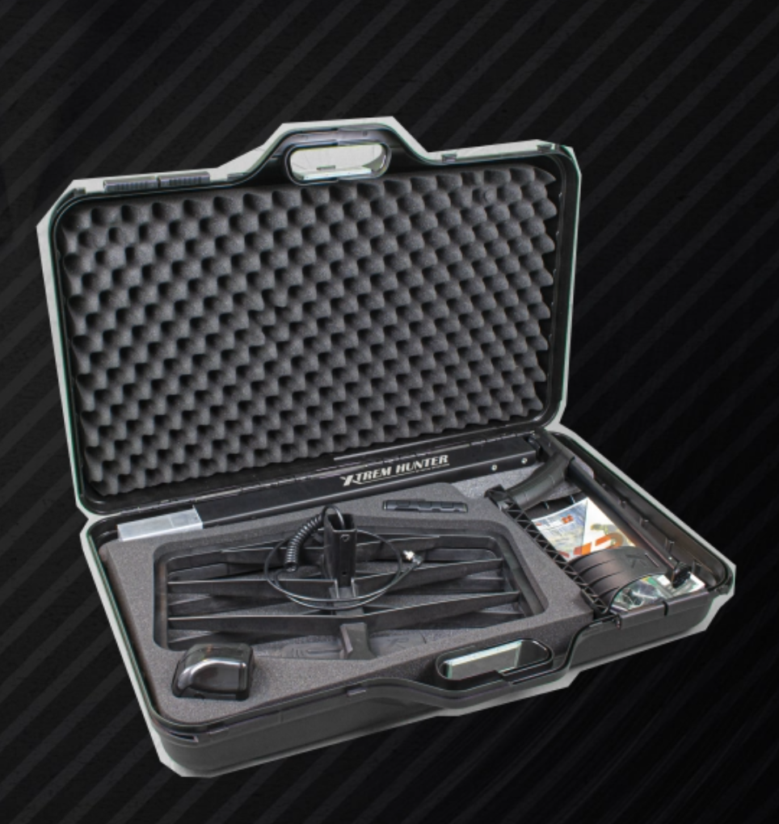
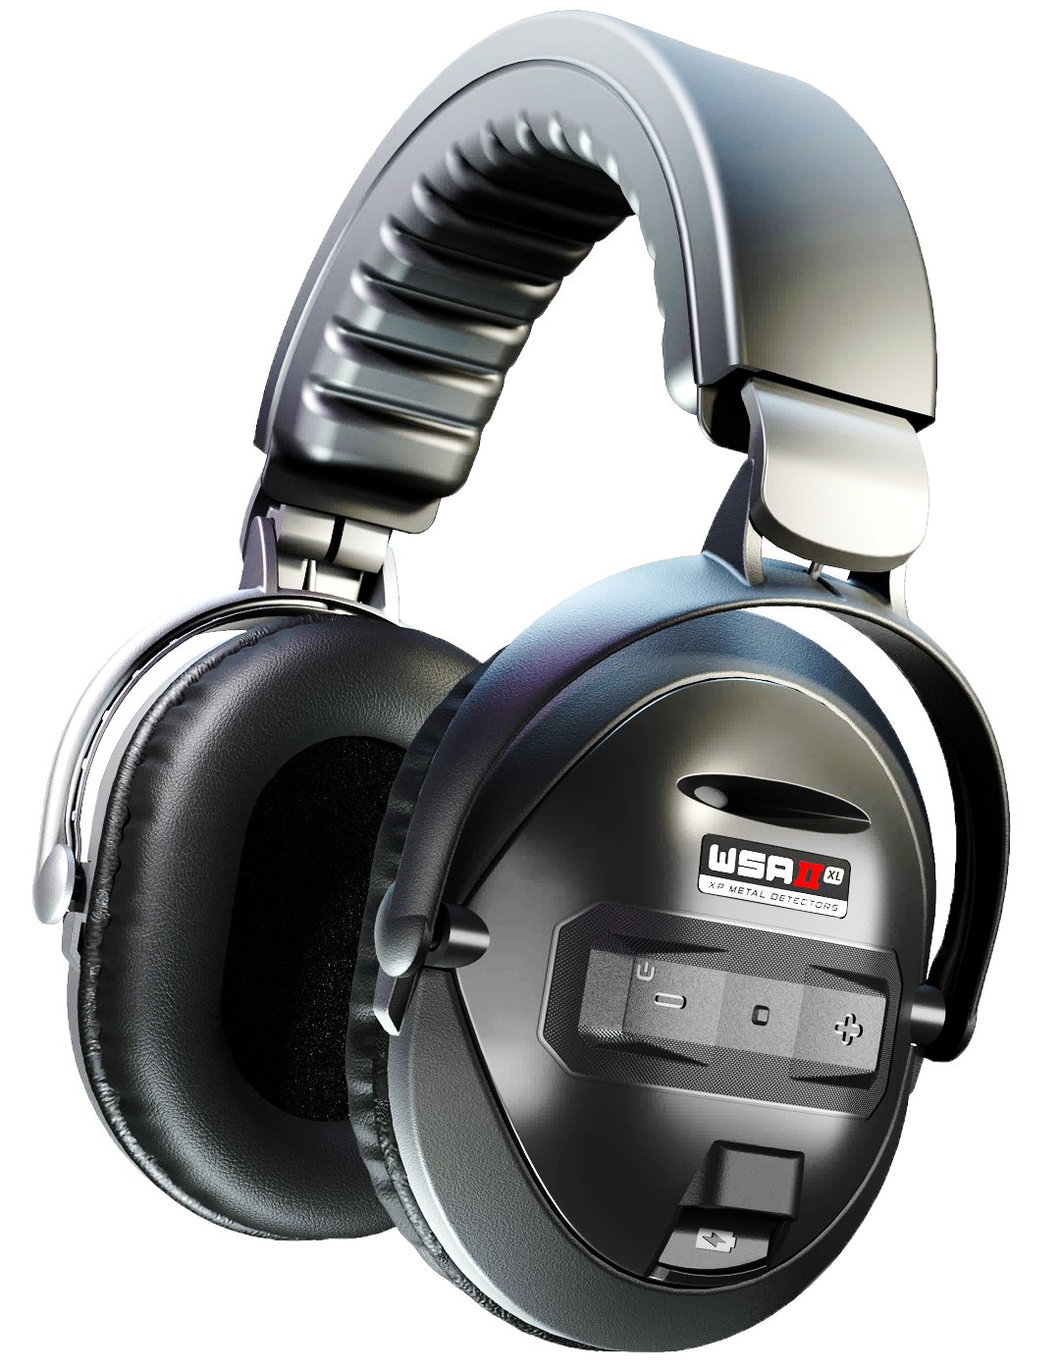
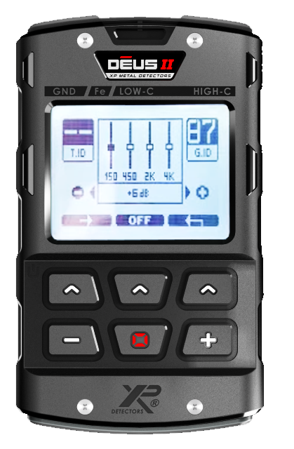
XTREM HUNTER Range at Launch
XTR-115RCWSA2XL
XTREM HUNTER Deep seeking detector
  XTR-115 Bundle (see previous slide)
  DEUS II Remote control (D2-RC) without case
  WSA II-XL Wireless Headphones
  DEUS II User Manual
  Accessory kit (with charger)
  MSRP: 2082.50 Euros / US$ 2,399.00
  MSRP VAT included : 2499 Euros
Nomenclature:
XTR-115RCWSA2XLFE for French manual and EU charger
XTR-115RCWSA2XLEE for English manual and EU charger
XTR-115RCWSA2XLEG for English manual and UK charger
Only this three versions will be available at launch
More versions to come in September after translation

Slide 21
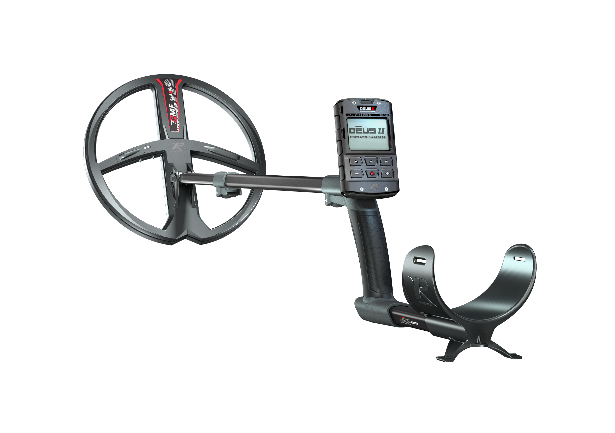
XTREM HUNTER Range at Launch
  XTR-115 + DEUS II RC Detector + WSAII-XL
  DEUS2-22FMFRC or 28 or 3428
  + WSA II-XL Wireless Headphones
  + XTR-115
  Bundle not available in XP : Do it yourself
  MSRP : 2499.17 Euros / US$ 2,799.00
  MSRP sales tax included : 2999 Euros
+
+

Slide 22
XTREM HUNTER : 3 versions
  XTR-115 bundle for DEUS II detector
  XTR-115RCWSA2XL Detector
  XTR-115 + DEUS II RC Detector+ WSAII-XL
+
+

Slide 23
XP REFERENCE | ACCESSORY DESCRIPTION
XTR115RX+TX | XTR Reception and Transmitter coils Coil XTR115RX and XTR115TX, supplied with screws
XTR115RX | XTR115RX Reception Coil (1'x1.5', horizontal), for Repair only
XTR115TX | XTR115TX Transmitter Coil (1'x1.5', horizontal), for Repair only
XTR-STEM | XTREM HUNTER S-Telescopic Stem with Armrest, aluminium tubes and screws
XTR-COIL-SCREWKIT | Screwing Kit for XTR Coil
XTR-STEM-SCREWKIT | Screwing Kit for XTR Stem
XTR-STEM-STRAP | XTR Stem Strap
XTR-CASE115 | XP Case for XTREM HUNTER XTR-115
CUSB-C | USB / USB-C Charge cable
XTR115-MANUAL-FR | XTR-115User Manual - French
XTR115-MANUAL-UK | XTR-115User Manual - English
XTR115-MANUAL-GE | XTR-115User Manual - German
XTR115-MANUAL-SP | XTR-115User Manual - Spanish
XTR115-MANUAL-RU | XTR-115User Manual - Russian
XTR115-MANUAL-CN | XTR-115User Manual - Chinese

Slide 24
  Q&A

Slide 25
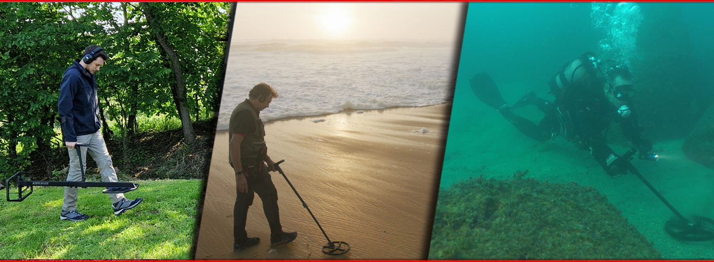
eXPlore like never before !

